Slide 1
Customer service in the Energy sector
Final report – Executive Summary
2nd July 2019

Slide 2
Citizens Advice Energy Sector Exploration 2019 - Project Scope
This report from the Insight Consultancy division of The Institute of Customer Service was prepared for Citizen’s Advice to help understand how energy consumers’ customer service needs have evolved since 2015 in the UK, and how this compares to other regulated sectors (finance, telecommunications and media, water).
Specifically Insight Consultancy identified:
What matters most to energy customers
How well they feel that their energy suppliers are meeting their needs
How energy suppliers can maintain good service in a complex industry (including for customers in vulnerable situations)
Future challenges as the energy sector evolves
Opportunities for energy suppliers to better serve customers (including customers in vulnerable situations)
Customer service in the energy sector
Perspectives for now & the future

Slide 3
What matters most to energy customers?
Customer satisfaction with the energy sector is primarily driven by relationship factors, communication and price. Reliability of their energy supply is not cited by consumers as a key driver of satisfaction, it is seen as a basic expectation that energy suppliers need to deliver.
In general, customers place greater importance (8+ /10 average) on customer service metrics in regulated sectors than in other sectors. Women and older consumers place higher importance on customer service than other key demographics.
Energy is not often at the front of their customers’ minds and decisions around suppliers are often driven by price. Being rewarded for staying with the same supplier is important to customers, as is assistance from energy suppliers if they do decide to switch.
How well are customer needs met by energy suppliers?
Over the entire period of this data set (January 2016-19), customer satisfaction with energy companies in the UK is slightly lower than the UK sector average (7.32 vs 7.61). This is in line with the UK utilities sector, which also underperforms the UK sector average.
A slight decline in satisfaction has been recorded over the last 3 years (from 7.19 in January 19 to 7.29 in January 18 and 7.5 in January 2017) which is not statistically significant.
Despite a satisfaction score of 7.32/10, the energy industry has a poor reputation among consumers, attributed to complexity and lack of transparency. Related to to this, there is a lack of trust in energy companies among its customers, they feel that energy companies don’t care about them and are only looking to make large profits. Respondents said that energy companies are “hiking up” prices, don’t communicate changing tariffs well and bills are too complicated. These issues are acknowledged by industry experts.
Key findings – What matters most to energy customers and how well are their needs met?

Slide 4
Energy companies are trying to embrace customer centricity but are behind other regulated sectors
Energy experts say the focus of the energy industry is shifting slowly from engineering to customer centricity - however, customers say more needs to be done by the industry to make it customer-centric beyond introducing multiple contact channels.
This research has highlighted a clear opportunity to improve trust through proactive communication with customers, informing customers how their money is spent as well as providing support on billing, switching and the best available tariffs.
Energy is regarded as a commodity so is not at the front of mind of customers and supplier choice is generally driven by price. Rewarding customers for loyalty to energy providers is important them - a key area of customer relationships which has not yet been fully explored by the industry.
Energy providers need to get it right first time: most consumers contact their supplier infrequently (as little as once during their tenure with a supplier) so that contact needs to give a positive impression.
Within this context, it is perhaps unsurprising that the majority of opportunities to improve focus on customer needs directly relate to information provision and transparency around switching, deals, price and loyalty.
A further area of focus should be on the relationship suppliers have with their customers – consumers want be treated as individuals and value a personal and proactive service – which is even more important for customers in vulnerable circumstances. Much can be done by the industry for the latter, starting with ways to better identify customers in vulnerable circumstances and engage with them.
Key findings – How to maintain good service in a complex industry?

Slide 5
Industry experts agree that the industry is ripe for change and innovation. Experts expect many future developments to be driven by technology – something seen as a necessity.
  Most experts interviewed predict a future of self-sufficiency and local partnerships, which will be driven by technological developments in generation. Furthermore, they expect further consolidation among players. Experts predict that many new entrants will fail to survive in the longer term.
  In addition, industry experts expect there to be a move away from the traditional “left to right” model - whereby energy is generated in large centralised hubs and distributed to passive consumers – towards a pluralistic, diversified future including self-generation (e.g. via solar panels) and trading. With this there is a danger that customers in vulnerable situations get left behind, because there will continue to be major capital costs for a customer to set up self-generation capabilities. This can preclude (in particular) low-income customers from participating. The industry will have to put special measures in place to avoid this from happening, experts explain.
  In this model, experts say that energy suppliers become partners and enablers (“a neutral broker”) rather than simply top-down suppliers of energy. An example of this is consumers selling back self-generated energy. This may be harder to manage centrally. Energy experts think it is therefore likely to be managed more locally by numerous energy companies.
  Within the industry, there is some nervousness around new technologies, e.g. with the use of AI and chat bots. Although chat bots can be useful, they are perceived to be impersonal by some customers. As a first step, experts cite that it is important to get their analytics right, and use this to better serve their customers. This means that it will be easier to move from being reactive to being more proactive with their service.
  Overall, there is strong support for Ofgem, but industry experts have varied views on
  what Ofgem’s role should look like
Key findings – Future challenges and opportunities for energy suppliers to better serve customers
(i) Experts’ perspective

Slide 6
Innovations
To date, customers have failed to see the benefits of most innovations, such as smart meters, so far. Communication and education will be key in adoption of new developments, and energy companies have a fundamental role to play in this, as well as government and Ofgem.
Renewable energy is seen as a good development in theory, but consumers do not want to pay more for it than for regular energy. The perception is that renewable energy is more expensive and should be the provider’s responsibility to fund.
Communication
Energy customers would like to see that communications get improved by their providers, by being more proactive about energy consumption and by providing energy saving tips to consumers
Consumers say they would welcome a more personal approach, and communication beyond being sent their bills only. They say they would like to receive a more personalised service, whereby customers can tap into advice and information relevant to their circumstances. For example, by providing new mothers advice on energy efficiency of cold water sterilizers vs. hot water ones.
Although many consumers never contact their energy supplier, when there is the need for contact, they’d like to be able to use a multitude of channels. Some prefer to pick up the phone, whilst others would use email or chat functionality on websites. This is driven by personal preference and circumstance, but ease of use stands central across all channels.
Key findings – Future challenges and opportunities for energy suppliers to better serve customers
(ii) Customers’ perspective

Slide 7


Linking consumer & industry expert themes highlights
Comparing the themes from consumer and expert interviews, highlight the differences and similarities in priorities for both groups.
Consumer themes
Knowledge – there is a lack of understanding about the complex energy market
Innovation – Needs a clear customer benefit
Commodity – Energy is not at the forefront of consumers’ minds
Relationship – there is an opportunity to improve the customer experience (CX) when things go wrong.
Transparency – customers need simpler, clearer and more proactive communications
Loyalty & price – with a perceived lack of reward for loyalty, decisions are driven by price.
Expert themes
Change – the pace of change in the industry is accelerating and both providers and Ofgem will need to educate customers to keep them up to speed.
Future developments – these will be driven by technology but must meet customer need for a related benefit.
Low touch – the network is well maintained and functioning so this is a low touch market - customers do not think about energy much.
Multiple factors improve CX – many of which could be addressed with more focus on personal and a more relationship-oriented approach.
Vulnerable customers – these need more support from energy providers
Bad reputation – the energy industry believes it has a bad reputation amongst consumers who say this is driven by a lack of transparency and complex pricing.

Slide 8
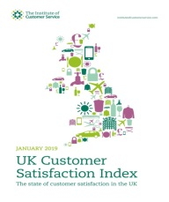

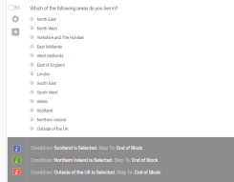
Desk Analysis
Reviewing existing data sets (UKCSI & UK Customer Priority data) to understand the evolution of customer service within the energy sector.
Methodology Framework
Qualitative
The outcomes that count: Exploring consumers’ and industry experts’ worlds.
Quantitative
Validating the outcome statements derived from the qualitative stage themes to build a robust model of opportunities for the energy sector.
Source: ICS Customer Service in the Energy sector – April 2019.

Slide 9
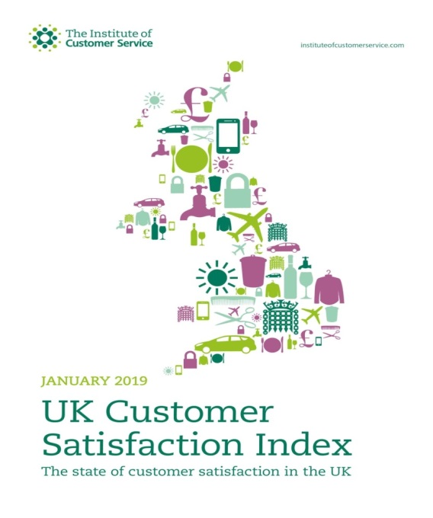
1. Foundational data set
Independent national benchmark of customer satisfaction
11 years of data
13 sectors
45,000 responses per wave
25 + customer experience
Channel use and satisfaction
Causes of complaints and satisfaction with complaint handling
Customer Priorities: customer experience metrics (most important)
Qual. & quant insight – 52 telephone interviews & 2,600+ online panel
200 responses per sector x 13 sectors*

Slide 10
1. Starting point – desk analysis
For this Citizens Advice project:
Seven waves of UKCSI datasets.
2015 & 2019 Customer Priorities research reviewed - to identify & explore trends in perceived importance & performance for a full range of customer service metrics.
Analysis identified the following:
Drivers of customer satisfaction
Trends in importance and performance, including by channel, different customer groups & relevant behaviours
Relationships between overall satisfaction and different aspects of service performance
Comparison of energy with other regulated sectors, i.e.: financial services and telecommunication/ media

Slide 11
During the qualitative phase, 30 face-to-face and telephone interviews took place with consumers and energy industry experts (50/50 interview ratio) . All interviews were recorded either on video or audio.
Energy industry expert interviews included conversations with senior customer service and customer experience professionals from networks, retailers and data services businesses.
Topics covered included;
Overview of their business
Business outlook and the wider energy market
The role of customer service within the energy market
Consumer interviews included conversations with consumers from a range of ages, geographical locations and income groups.
Consumer topics covered:
Life story
Family and domestic situation
Experiences with energy to date
The role of energy in their lives
Views on the energy industry in general
Methodology – qualitative phase

Slide 12

2063 online consumer surveys
Representative England, Wales and Scotland sample
Understanding the importance and performance of 47 opportunity statements across 8 themes (Contact, Ease, Information, Innovation, Knowledge, Price, Relationship, Supply) identified in the qualitative/ consumer interviews phase
An opportunity score was calculated for each opportunity statement, and also for the 8 overarching themes (as derived from the original 6 themes from the qualitative / consumer interviews phase)
Methodology – quantitative phase

Slide 13
Desk based analysis
UK Customer Priorities & UKCSI

Slide 14
Our starting point
Independent national benchmark of customer satisfaction
11 years of data
13 sectors
45,000 responses per wave
25 + customer experience
Channel use and satisfaction
Causes of complaints and satisfaction with complaint handling
Customer Priorities: customer experience metrics (most important)
Qual. & quant insight – 52 telephone interviews & 2,600+ online panel
200 responses per sector x 13 sectors*
Source: ICS Customer Service in the Energy sector – Desk based research, April 2019. The Institute of Customer Service report “Experiences, Emotions and Ethics. Refreshing the customer priorities that underpin the UK Customer Satisfaction Index”.
* Sectors: Automotive, Banks & Building Societies, Insurance, Leisure, Public Services (Local), Public Services (National), Retail (Food), Retail (Non-food), Services, Telecommunications & Media, Tourism, Transport, Utilities

Slide 15

Analysis of 7 waves of UKCSI datasets as well as 2015 and 2019 Customer Priorities research, to identify and explore trends in terms of perceived importance and performance for the full range of customer service metrics.
Analysis identified the following:
Drivers of customer satisfaction
Trends in importance and performance, including by channel, different customer groups & relevant behaviours
Relationships between overall satisfaction and different aspects of service performance
Comparison of energy with other regulated sectors, i.e.: financial services and telecommunication/ media
Methodology
Source: ICS Customer Service in the Energy sector – Desk based research, April 2019.

Slide 16
Key desk based research findings
Great importance (8+ /10 average) on customer service metrics in regulated sectors
Supply reliability, complaint handling, competent and helpful staff as well as ease of dealing with the supplier are key priorities for energy customers.
Women and older consumers place higher importance on customer service.
Overall satisfaction with energy suppliers is relatively high (7.32 out of 10). Broadly equivalent to other utilities. This has remained stable over past 3 years.
Suppliers’ relationship with their customers (their reputation, customers’ trust, their transparency and whether customers feel they care) were – combined - the strongest drivers of overall satisfaction, followed by price.
Source: ICS Customer Service in the Energy sector – Desk based research, April 2019.

Slide 17


How important or unimportant each of the following factors are to you?
Mean importance scores across all factors (July 2015 – 47 & January 2019 – 41 factors**) (scale 1-10)
Importance of customer service in the UK
Source: ICS Customer Service in the Energy sector – Desk based research, April 2019.
Base: UK Customer Priorities Data July 2015 & January 2019 (Banks & Building Societies n=240 & 200, Insurance n=240 & 200, Telecommunications & Media n=240 & 200, Utilities n=240 & 200, Energy n=158 & 122, Water n=66 & 68, UK All sector average n=3120 & 2600 respectively). *Base less than 100. ** The full list of factors can be found in the appendix. *** Please note that the sum of Energy and Water will not add up to the Utilities total n, because within utilities there were brands/ suppliers that were classified as “Other” and hence could not be grouped to either Energy or Water.

Slide 18
How important or unimportant each of the following factors are to you?
Mean importance scores top 10 factors (July 2015 – 47 & January 2019 – 41 factors**) (scale 1-10)
Energy sector
Top priorities in the energy sector
Supply reliability, complaint handling, competent and helpful staff as well as ease of dealing with the supplier are key factors
Source: ICS Customer Service in the Energy sector – Desk based research, April 2019.
Base: UK Customer Priorities Data Energy sector (July 2015 n=158, January 2019 n=122).
Significantly higher when compared to the UK All sector average, Significantly lower when compared to the UK All sector average
*Unique per wave attribute; was not asked in 2015.

Slide 19
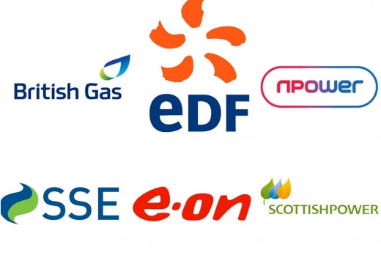

Mean importance scores across all factors (July 2015 – 47 & January 2019 – 41 factors**) (scale 1-10)
Energy sector
Importance of customer service in the energy sector
Women and older consumers place greater importance on customer service compared to men and the younger population
Source: ICS Customer Service in the Energy sector – Desk based research, April 2019.
Q: How important or unimportant each of the following factors are to you?
Base: UK Customer Priorities Data Energy sector (July 2015 n=158, January 2019 n=122).
** The full list of factors can be found in the appendix.

Slide 20
Drivers analysis methodology
Data was taken from the UKCSI survey – from January 2016 to January 2019** (waves 18-24) [55,000 rating of organisations, and 15,105 rating of energy suppliers]
Representative of the UK
Energy suppliers’ performance across 24 attributes were captured consistently from January 2016 – July 2018*
Drivers analysis (relative importance) was conducted to determine the impact of these individual attributes on overall satisfaction with energy supplier
* Where attributes related to interactions with a specific channel (e.g. “in person”, or “by phone”) these were merged with other channels to create an overarching measure of “speed of response”, for example.
** In the most recent wave – January 2019 – the attributes were revised. For this reason the final wave was excluded from the drivers’ analysis reported in this deck. However, separate analysis of those attributes consistent across all waves confirmed a similar pattern of response as shown for waves 18-23.
Source: ICS Customer Service in the Energy sector – Desk based research, April 2019.

Slide 21
% Overall satisfaction – by sector
Mean satisfaction
(scale 1-10)
7.96
Overall Satisfaction
Three out of four say that they are satisfied with their energy supplier, but there is opportunity for improvement
7.94
UK All sector average 7.61
7.50
7.35
7.32
Source: ICS Customer Service in the Energy sector – Desk based research, April 2019.
Q3. How satisfied or dissatisfied are you with XX overall?
Base: UKCSI Data Jan 2016 – Jan 2019 (See chart)
Significantly higher when compared to the UK All sector average (7.61), Significantly lower when compared to the UK All sector average (7.61)

Slide 22
Attributes’ relative importance for overall satisfaction (%)
Drivers analysis (relative importance)
Customers’ relationship with their supplier (reputation, trust, and care) have the greatest impact on satisfaction ratings.
Q2: We would like to know how satisfied or dissatisfied you are with XX by asking you to score the list of factors below. So thinking about your last experience of XX, what score would you give for: / Q3: How satisfied or dissatisfied are you with XX overall?
Drivers analysis (Relative importance). Overall satisfaction as dependent variable.
Base: UKCSI Data Jan 2016 – Jul 2018. Ratings of energy suppliers only (See chart)

Slide 23
Satisfaction with top 5 drivers, and overall for energy supplier – by wave
Mean satisfaction scores (Scale 1-10)
Overall satisfaction in the energy sector
(trends over time)
5 key drivers remained stable since January 2016.
However, there is a stronger decline in price, transparency and trust.
Source: ICS Customer Service in the Energy sector – Desk based research, April 2019.
Q2: We would like to know how satisfied or dissatisfied you are with XX by asking you to score the list of factors below. So thinking about your last experience of XX, what score would you give for: / Q3: How satisfied or dissatisfied are you with XX overall?
Base: See chart

Slide 24
Qualitative phase

Slide 25
30 face-to-face and telephone interviews (15 consumer and 15 energy industry experts). Energy industry expert interviews covered networks, retailers and data services businesses. Consumer interviews covered a range of ages, geographical locations and income groups.
All interviews were recorded either on video or audio
Consumer topics covered:
Life story
Family and domestic situation
Experiences with energy to date
The role of energy in their lives
Views on the energy industry in general
Industry experts topics covered:
Overview of their business
Business outlook and the wider energy market
The role of customer service
What we did during the qualitative phase

Slide 26

Trust and communication
There is opportunity to improve trust by improving (proactive) communication to consumers, both in terms of knowledge provision with regards to how consumers’ money is spent, as well as providing support with regard to billing, the best tariffs available and switching. Although the industry is slowly shifting from having an engineering focus to customer centricity, this has to incorporate more than having a multitude of contact channels available.
Bad reputation
The energy industry has traditionally suffered from a poor reputation with consumers. Key things which have contributed to this are the complexities and lack of transparency in the market – a view which is acknowledged by industry experts.
Qualitative phase –
Key themes summary
Impending change and technology driven future
Industry experts agree that the industry is ripe for change and innovation; many future developments will be driven by technology – something which is seen as a necessity. Consumers on the other hand, have failed to see the benefits of innovations such as smart meters. Communication and education is key in adoption of new developments, and energy companies have a fundamental role to play in this, as well as government and Ofgem. A special emphasis needs to be placed on vulnerable customers, who don’t always feel they are being served well enough by the industry
Customer centricity
Given the level of change and consolidation within the industry (and more is expected to come), customer centricity is, and will be, crucial for energy companies to survive in a tough marketplace.
Commodity
Energy is generally not at the forefront of consumers’ minds and is regarded as a commodity – something which is always available. As a result of this, many consumers find it difficult to distinguish between deals from providers and may not switch at all. For consumers, being rewarded for loyalty is important, which has not fully been acknowledged yet by industry experts. Those who do switch, tend to do so to find a better deal elsewhere – energy providers could do much to improve supporting consumers on this journey.

Slide 27

Key consumer themes
Six key themes emerge from interviews with consumers that are important to understanding, and then supporting consumers to achieve their missions
Commodity
Energy is not at the forefront of consumers’ minds
Knowledge
There is a lack of understanding about the complex energy market
Loyalty & price
With a perceived lack of loyalty, decisions are driven by price
Transparency
A need for more simple, clear and proactive communications
Innovation
Must have a clear customer benefit
Relationship
There is opportunity to improve customer experience when things go wrong
Source: ICS Customer Service in the Energy Sector - qualitative research with consumers, April 2019. N=15

Slide 28
“I expect priority service for people with children and those who are very ill.”
Network vs. suppliers
The energy market is seen as very complex and many consumers don’t understand the supply chain and different players within it. Especially evident is the confusion between what network providers and energy providers (retailers) are.
Lack of consumer knowledge
Consumers see the market as very complex. There is a lack of knowledge about the energy market and its providers among consumers. There is an opportunity for energy suppliers to increase trust and improve reputation by educating consumers on how the market works, and simplify the industry where possible.
Little differentiation
Consumers struggle to differentiate between energy providers, “energy is energy, it’s all the same”. Switching is seen as complicated and there is little difference between providers. Furthermore, it is seen as inconvenient to change direct debits and other payment methods for something which is seen as one and the same product.
Consumers can feel confused by their bills
There is confusion about the information on bills, total energy usage in general and how bills are calculated. Some of this is related to bills using estimates rather than actual meter readings. This can lead to consumers not looking at their bills at all.
What is available for vulnerable customers?
Often vulnerable customers do not realise they are categorised as such. Many are unaware of the priority service register and how vulnerable customers are defined. When the definition is explained, there is a lack of identification with the term – e.g. a single parent with young children may not classify herself as vulnerable.
“ I don’t know what tariff we’re on. We’ve probably kept the letter, but I have no recollection of the detail.”
“Don’t see point in changing supplier – whoever I’m with it’s the same.”
Source: ICS Customer Service in the Energy Sector - qualitative research with consumers, April 2019. N=15

Slide 29
“I’m not ‘techy’ – I don’t want to know how much energy we use. In the end I have to do things like running baths – how does it help that we know how much energy that uses?”
Few considered luxuries
Energy consumption is something which happens in the background, a necessity for life. Consumers want to be comfortable in their homes and maintain their lifestyle. Staying warm, using hair straighteners, playing video games – very few things are considered extraneous or superfluous consumption.
So ubiquitous it is forgotten
Energy is considered a commodity, it is so integral to daily life that consumers don’t give it much thought. This is partially due to the reliable network in the UK – many don’t encounter any issues so never have to contact their energy provider unless it is to switch supplier (once or twice in their lifetime?). Contact is more often related to billing issues than supply issues.
Commodity
Energy is not at the forefront of consumers’ minds for numerous reasons, such as energy being considered to be a commodity, as well as complex. As switching is seen as too difficult by many consumers, there is an opportunity for energy suppliers to either help more with switching or reward loyalty through lower pricing and discounts.
Out of sight, out of mind
Many consumers don’t think about paying the energy bill (it is often on direct debit due to convenience) and is viewed to be of the same importance as other utility bills and food shopping. This is different for some vulnerable customers on pre-paid meters, who are sometimes forced to travel with difficulty to be able to top up.
Better the devil you know
People are very risk and loss averse by nature and as switching is seen as complicated, the consideration of effort/reward is not good enough for many consumers. Many consumers would not mind paying a little extra if this means not having to switch.
Source: ICS Customer Service in the Energy Sector - qualitative research with consumers, April 2019. N=15

Slide 30
“Customer service and how much the supplier charges per kW is key for me, but price comes first.”
.
Price & loyalty
Despite energy not being the number one household consideration, decisions are driven by price charged by energy companies, and consumers feel energy providers should reward loyalty.
Frequent price hikes, lack of loyalty reward and inconsistent care of vulnerable customers contribute to the industry’s bad reputation, say consumers.
Rewarding loyalty presents an opportunity to providers, who could do more to offer the best possible price to existing customers and vulnerable customers specifically.
No incentive to stay
Consumers feel that energy companies increase their prices for no apparent reason, year after year. In other words, loyalty is not rewarded, which reinforces consumers’ negative perceptions of providers.
Those who do switch, tend to be regular switchers (i.e every year) and do so to get the best possible deal. “Companies who offer to price match only when you complain or tell them someone else is cheaper. Why don’t they offer the best price in the first place?”
The younger generation appears to be more price conscious than the older generation, and hence more prone to switching.
Price becomes primary consideration
Due to a lack of knowledge or any real interest in energy, price is usually the main driver of choice if and when consumers decide to switch. Most consumers do not do too much research as long as they feel a tariff is within their expected budget.
Vulnerable customers are more likely to be on pre-paid meters than others, even though they frequently feel this is often more expensive, they often think they have no choice.
Some energy companies are seen as supportive of vulnerable customers, whereas others fail those who are most in need. The approach energy providers take, appears to be inconsistent.
“Price has been a switching factor in the past.”
Source: ICS Customer Service in the Energy Sector - qualitative research with consumers, April 2019. N=15

Slide 31
“I will tend to use email, my husband will tend to use the phone – phoning is a faff, automated choices – too much hassle. I think email gets dealt with quicker.”
Complexity leads to suspicion
Often energy companies are seen as wanting to rip off the consumer by hiking up the prices, and not making them aware of changing tariffs in a clear and transparent enough manner. An example of this is having to pay an additional amount for smart meter readings, which the consumer was not aware of beforehand.
Likewise, bills are seen as too complicated, which leads to consumers not looking at them at all.
Consumers want more pro-active support
Communications could be improved by energy suppliers by being more proactive about energy consumption e.g. providing energy saving tips.
Consumers say they would welcome a more personal approach, and communication beyond being sent their bills only. They would like a service, where they can tap into advice and information relevant to their circumstance e.g. one consumer mentioned that, as a mother with young children, she would like to know how much money a cold water sterilizer could save vs. a hot water one.
Transparency
There is a need for industry simplification and putting the consumer at the heart of what energy companies do. Currently, energy companies are seen as not transparent about pricing and switching – there is an opportunity for energy companies to improve their communications, be more transparent, and broaden it beyond billing communications only.
Need for easy communication
Although many consumers never contact their energy supplier, when there is the need for contact, they’d like to be able to use a multitude of channels. Some prefer to pick up the phone, whilst others would use email or chat functionality on websites. It is down to personal preference and circumstance, but ease of use stands central across all channels. E.g. some consumers prefer letters as they like physical copies, whereas others prefer telephone as this is seen as straightforward.
Source: ICS Customer Service in the Energy Sector - qualitative research with consumers, April 2019. N=15

Slide 32


“I don’t like smart meters as I’ve heard that people who have one noticed an increase in usage/ spending despite following the same routine before the smart meter. I wouldn’t want to try it unless there is enough information and evidence to explain how a smart meter works.”
Innovation
Consumers are wary about innovation, there needs to be a clear benefit, often cost related. Currently, many consumers don’t feel there is a strong enough benefit to using smart meters or intermediaries. Energy providers could do more to educate consumers on the benefits to encourage usage. Similarly, the benefits and importance of using renewable energy are not communicated clearly enough – this presents an opportunity to the industry.
Under-delivering on ‘Smart’
Smart meters are nice to haves, but are not used to their full ability. They are used to monitor increase in energy consumption for particular appliances. It is not regarded as a cost-saving tool
Many consumers are even wary of smart meters as some are supplier-specific, and they would prefer “not to have the faff of having to change meters when changing providers.”
Hesitancy around intermediaries
Opinions are divided about intermediaries, whereby multiple utilities are managed by the same supplier. The main advantage is ease of use and efficiency.
However, some are concerned that it might not be beneficial from a costs point of view, and “if one thing goes wrong the rest is likely to go wrong too.”
Saving before sustainability
Renewable energy is seen as a good development in theory, but consumers do not want to pay more for it than for regular energy. The perception is that renewable energy is more expensive and should be the provider’s responsibility to fund.
“Don’t think I use it [smart meter] properly. I don’t check it! Don’t know what difference it would make”.
Source: ICS Customer Service in the Energy Sector - qualitative research with consumers, April 2019. N=15

Slide 33
“When I ring [energy supplier] up, their operators are very nice and helpful, but I don’t think the board cares about the customer nor their employees. They care more about its money. “
Price hikes and profit machines
Price hikes are the main cause for distrust and the view that energy companies don’t care about their customers. They feel energy companies make large profits at the expense of the consumer and even try to trick consumers into more expensive tariffs.
There is also a perception that providers actively try to ‘ignore’ customers, and dread having to try and resolve any issues.
Some consumers mentioned that they feel that energy providers are not proactive in terms of offering relevant advice to their customers with regards to pricing in particular.
Good customer experience is essential for trust, say consumers
Although contact with energy providers is infrequent, when it does happen it is usually because something has gone wrong. This could be with regards to energy supply, but is more likely to be with regards to billing issues.
Good customer experience and service is essential to make things right, which is driven by knowledgeable staff, ease of contact/solution and delivering on promises.
Furthermore, consumers are looking for staff friendliness and the ability to simplify complex situations if need be.
Relationship
Consumers feel that energy companies don’t care about their customers. There is an opportunity for energy providers to improve relationships and trust not only by effective communication on aspects such as price, but also by focusing on customer experience and customer service.
“Companies offer to price match only when you complain or tell them someone else is cheaper – why don’t they offer the best price in the first place?”
Source: ICS Customer Service in the Energy Sector - qualitative research with consumers, April 2019. N=15

Slide 34

Key industry experts themes – interview summary
Senior energy industry professionals interviewed feel that the energy industry is rapidly changing and is ripe for disruption.
Customer experience is challenging for energy companies, but is becoming increasingly important in a ‘low touch’ market.
Change
Senior energy industry experts say that the industry is changing rapidly, with consolidation happening and new businesses entering the market. The experts feel that the market is ripe for more change with regards to numerous factors, e.g. technology used and customer experience.
Bad reputation
Experts cite that the industry has had a bad reputation, historically speaking. This is driven by internal factors, such as lack of clarity on pricing to customers, as well as external factors, such as Ofgem regulation.
Low touch
The energy market is ‘low touch’, say experts. In other words, customers generally don’t have to get in touch about energy supply issues, as the network is very reliable. They do feel that customer service can be a challenge in this environment, as energy suppliers have to get it right first time round.
Multiple factors to improve customer experience
In order to improve customer experience, experts think that there is a need for market simplification, speed of resolution, multi-channel offering and getting the basics right. This customer centric approach has to be embedded throughout the organisation for it to truly work.
Vulnerable customer focus
With regards to vulnerable customers, experts recommend that work needs to be done to effectively identify these people, and to move away from ‘blunt’ definitions.
Industry supportive of Ofgem
The industry professionals are highly supportive of Ofgem, but they do have varied opinions on what Ofgem should be focusing on.
Future development likely to be driven by technology
Experts expect that the industry will move towards self serve. This means that consumers might have self-generation systems, as well as manage all their needs digitally through the likes of apps. Furthermore, experts expect that the industry will move away from the traditional ‘left to right’ model, whereby energy is generated in large centralised hubs and distributed to passive consumers – towards a pluralistic, diversified future including self-generation (via solar panels etc.) and trading.
Source: ICS Future of Energy qualitative research with industry experts, April 2019. N=15

Slide 35
“We want to radically change the gas market, by making it simpler and more efficient.”
“I like dealing with DPD [parcel operator] better than I like dealing with us.”
Industry experts see the market as changing and ripe for disruption
The industry is slowly moving away from seeing themselves as pure engineering experts to a stronger focus on customer experience. They say that new entrants to the market are raising the bar with customer experience – in order to remain competitive, energy experts feel further transformation is necessary to become truly customer centric.
According industry experts, there is much change in the energy market
Experts report that there is consolidation amongst existing energy players and there are a number of new market entrants. According to the experts, the new entrants are changing the market, and are often highly agile. Some have venture capital backing and low operational costs. Industry experts say that this allows them to raise the bar with regards to customer experience, through being able to target specific audiences, develop customer centric contact channels (often digital, such as apps), without the burden of legacy IT systems and operational models which are no longer suitable for a changing market. Furthermore the industry experts feel that new entrants drive down consumer energy pricing, and therefore profit margins in the energy industry overall.
There is a slow shift from energy companies perceiving themselves as engineering experts to focusing more on customer experience, say experts
Historically, energy companies have perceived themselves primarily as engineering experts, with the ability to establish, maintain and fix complex systems - many of our participants have worked in the energy industry for their whole careers with no exposure to other sectors. The experts say that this is slowly changing as many of the large players are or have been in the process of reconfiguring themselves with regards to operating models and technology infrastructure, in order to put the needs of the customer on the foreground and at the heart of everything they do. Examples of this are replacing their IT systems or putting in place more channels for customers to contact them at a time convenient to their customers.
“Customer service is a vehicle that makes your business more efficient and better.”
Source: ICS Customer Service in the Energy sector - qualitative research with industry experts, April 2019. N=15

Slide 36
“Cultural transformations are measured in years, not months.”
Experts do say that it has not been easy to adopt a customer centric approach
They state that this culture shift has not been an easy win; they have been dealing with myriad other changes in the market place, which can be a distraction. Furthermore there has been resistance from “traditionalists” within the businesses, some of whom take the view that customers are “stuck with” the supplier. Experts feel that the challenge is to persuade the business that becoming customer-focussed is not just a cost but can result in a more efficient, more profitable business
There is some nervousness around new technologies, according to industry experts
An example of this is the use of AI and chat bots. Although chat bots can be useful in some situations, they are perceived to be impersonal by some consumers. As a first step, experts cite that it is important to get their analytics right, and use this to better serve their customers. This means that it will be easier to move from being reactive to being more proactive with their service.
Embedding a customer centric approach is not easy, say experts
“We’ve invested in new digital platforms, which allow for self serve.”
Source: ICS Customer Service in the Energy sector - qualitative research with industry experts, April 2019. N=15

Slide 37
  To become a customer-focussed business, experts say there is the need to truly listen to and act on the needs of the customer
  Experts cite numerous examples of how this has been attempted;
  Experts’ businesses have been listening to the “voice of the customer” via customer panels , focus groups and other research vehicles in order to understand, co-create and drive business change. However, it’s recognised that it requires time and investment.
  Experts have also modelled planned courses of action against customer data to see how metrics such as NPS and CSAT will be impacted.
  Furthermore, experts say that they have been working constructively with external feedback, e.g. Ofgem customer surveys, to identify and address areas in need of improvement.
  Energy companies now recognise that employees are also customers, and harness their expertise to develop new approaches. One expert refers to “reversing the pyramid”, i.e. considering employees as the most important voices in the business.
Embedding the customer-focussed mind set across customer-facing staff is a challenge, according to experts
Experts comment that this is relatively easily done within call centre environments where monitoring, metrics and instant feedback can be effectively set up. However, it’s trickier in the field with engineers and other peripatetic staff.
Transforming energy businesses to becoming customer centric takes time and effort, according to experts
They feel that starting from inside the organisation with getting employees on board is key.
“The role of employee engagement is very important – there is a clear link to CSAT. We need to engage frontline teams in terms of what works for them, what doesn’t. Our mantra is to reverse the pyramid” – everyone’s role is to support the frontline. It’s a journey we’re on…working back from the customer.”
“I wouldn’t say anyone’s great (at customer service) yet…There are some examples of companies moving in the right direction.”
Source: ICS Customer Service in the Energy sector - qualitative research with industry experts, April 2019. N=15

Slide 38
Reliable energy supply is seen as key to good customer experience, say experts
One of the key elements of delivering customer service and experience is around energy supply, cite experts. They feel it is key to get the basics right first, by making sure energy supply is consistent and reliable.
Some experts say that customer experience success would be around awareness of better usage of energy, beyond renewable energy - for consumers to know how much energy costs for every occasion.
Clarity is seen as another key element to customer service and experience
Experts think that there currently is confusion around who is responsible for what in the event of problems or queries. It would help for consumers to know who is responsible for what within energy companies, according to experts.
Furthermore, experts think that consumers would benefit from simplification of the market. Currently, experts say that consumers don’t understand the need for multiple companies, each responsible for different aspects of the network.
Experts view speed, clarity and communication as essential elements to good customer service
Consumers would benefit from a simplified market, say experts. They feel that there is an opportunity for energy providers to provide more clarity in their communications and to play a larger role in educating consumers about the energy market.
Good problem resolution is seen as important by experts
Problems need to be solved in a speedy and safe manner as and when they arise.
At the same time, experts feel that it is important that customers are treated as human beings, not as engineering problems.
When engineering works take place, they need to be plenty of information in advance, with minimal disruption and effective clean up afterwards.
Multitude of channels is seen as vital
Experts cite that being able to get in touch with the supplier via the customer’s chosen channel(s), and recognising that the choice of channel will vary according to need is vital. Regardless of which channel customers use, they should not have to wait long for a response.
“You can be great in terms of customer service, but if you don’t get the basics right….”
Source: ICS Customer Service in the Energy sector - qualitative research with industry experts, April 2019. N=15

Slide 39
“We need to apply customer thinking to all parts of customer process, not just call centres, and we have been working on this need for 10 years. We have been learning from retail.”
Most energy companies have a wide range of customer contact channels available, say experts
Experts see a clear shift to digital, but telephone remains an important channel for most energy companies. Energy companies are increasingly moving towards a multi-channel approach.
An omni-channel approach to customer service is becoming increasingly common, cite experts
Moving to digital channels has clear cost benefits in many cases, according to experts, and can also provide customer benefits, such as increasing customer choice and ease of getting in touch;
One expert spoke about setting up an online tool enabling customers to obtain quotes for meter installation, which reduced costs (previously quotes were supplied in the context of a face-to-face visit) and was positively received by users.
A reduction in telephone capability can result in cost savings which can be passed onto customers.
Many experts do talk about the vital need to maintain telephone channels
  There is a recognition among experts that customers with a “once-in-a-lifetime” power cut will instinctively use the phone to report and receive immediate, personal reassurance.
  In practice there’s a delicate balance: ensuring customers can self-serve as necessary but making it clear that telephone is an option.
“We have multiple channels available for customers to get in touch. For instance, social, what’s app and text – they are all driven by customer need. To give you an example, young people are on social media, so are we.”
Source: ICS Customer Service in the Energy sector - qualitative research with industry experts, April 2019. N=15

Slide 40
The industry suffers from a poor reputation amongst consumers, according to experts
This is driven by some accurate consumer beliefs as well as some misconceptions, they feel. To improve their reputation, it is vital for the market to be simplified as well as become more transparent.
A complex and profitable industry contribute to bad reputation, think experts
  Experts have a strong feeling that they are in a industry which doesn’t have a great reputation – they mention a number of accurate consumer beliefs;
  Experts say that the industry is unnecessarily complex – there are a large number of players and it is not clear who does what. Some of this is the fault of energy companies themselves, some as the result of Ofgem mandates – but either way there is a need to counter these negative impressions constructively. There are various views as to whose responsibility this is; energy companies themselves, Ofgem, government and media (for example, covering “good news” stories about engineers fixing supply issues in difficult conditions).
  Furthermore, experts feel that the industry is not providing best practice customer service compared with brands which customers encounter on a day-to-day basis (e.g. Amazon).
  Industry experts say that there are also consumer misconceptions which contribute to the bad reputation
  One of the misconceptions mentioned is that energy companies make big profits. In fact, industry experts say that margins are not high, and the sector takes a lot of risks by investing heavily for the long-term future.
  Experts say that interventions such as planned interruptions can be badly received, but are seen as a necessity by industry professionals.
“Customers don’t understand and they don’t care.”
“Many customers still think there’s one organisation that does everything.”
Source: ICS Customer Service in the Energy sector - qualitative research with industry experts, April 2019. N=15

Slide 41
“Energy is very interesting when it’s not there…The rest of the time it’s viewed as a commodity.”
Experts say that due to continuous investment, the network has improved and outages are increasingly rare.
This, in return, has lead to customer engagement becoming an increasing rarity, according to energy experts. Engagement is more likely to be with regards to billing issues rather than provision of energy itself.
Typically, when a customer does get in touch, it is in a negative context, eg. to report a problem or to discuss billing. This may only happen once in a customer’s lifetime, explain experts.
The challenge for the suppliers is to get right first time, the experts think
Expert explain that energy suppliers need to build trust quickly, reassure during the process and solve the problem quickly.
Furthermore, they say because contact is so rare, and energy is viewed as a commodity - it’s the same energy, regardless of who supplies it. This makes the prospect of developing customer loyalty and encouraging recommendation in this market highly challenging.
Customer service can be a challenge in a ‘low-touch’ market, according to energy experts
They say that getting it right first time round, is key – this can be a differentiator for energy providers, especially given the commoditised nature of the industry.
“70% of customers ring us because it’s an emergency [ie. a power cut]. People don’t experience power cuts as much. So power cuts happen less, and people don’t know what to do. Customers need personal reassurance.”
“We’re meant to be invisible.”
Source: ICS Customer Service in the Energy sector - qualitative research with industry experts, April 2019. N=15

Slide 42
“Some situations require real time, personal support.”
  One key challenge is how to effectively identify vulnerable customers, say experts
  Experts feel there’s a need to move away from “blunt” definitions, for example “anyone over the age of 65” and towards more targeted and meaningful definitions – for example, including those suffering fuel poverty.
  Ideally vulnerable customers would identify themselves, but many are reticent to do so, or it wouldn’t occur to them to do so, according to energy experts. Furthermore, proactively identifying vulnerable customers could be seen as “big brother-ish”.
  Some experts use analytics to help them identify likely areas of vulnerability - for example, using socioeconomic data to target areas of fuel poverty – but this doesn’t identify individuals.
  Energy experts see working with vulnerable customers is as a positive social good
  Experts comment that energy companies work alongside social care providers to achieve great outcomes. Many are keen to go over and above what they perceive as their mandated responsibilities in this area.
  As an example experts cite working proactively with organisations such as Macmillan Cancer Support, or by having special programmes for consumers in the debt space to work on problem resolution.
  Experts feel there is a slow shift from being reactive to becoming more proactive, as well as adopting a more personal approach.
Many of the industry experts interviewed have personal responsibility for vulnerable customers
They mention that effective identification is a challenge however. This needs to be a focus for energy companies. Experts comment that some energy companies are seen as providing well for vulnerable customers, whereas others perform below par.
“It’s the right thing to do.”
Source: ICS Customer Service in the Energy sector - qualitative research with industry experts, April 2019. N=15

Slide 43
Energy experts are highly supportive of Ofgem
Especially Ofgem’s increased focus on customer service is praised, but there are some areas of disagreement amongst the experts.
Suppliers participate actively and willingly in Ofgem’s independent customer surveys, say experts
The regulator Ofgem is now much more focussed on customer service – it is keen to encourage and incentivise for good service, say experts. One experts points out that this is not the case in other markets. Ofgem sets customer service metrics to predict impact, trigger incentives etc. Experts explain that there is a particular focus on vulnerable customers, which will only increase – energy suppliers are very supportive of this, comment experts.
Furthermore, the regulatory contract is reviewed every 5 years. Experts say that good customer service is key for this, suppliers get a better deal for better service.
However, some experts feel that Ofgem needs to sharpen this focus and can improve further
Experts say that Ofgem could concentrate more on understanding customer expectations/desired outcomes rather than simply measuring satisfaction. This would help shift their focus from being reactive to being proactive.
    Some experts feel that Ofgem regulations can be overcomplicated, lacking transparency and clarity. This, in turn, can negatively affect customer experience.
    Lastly, it is felt by some experts that Ofgem needs to take a more proactive role in promoting the successes of the energy sector.
“I don’t envy the regulator.”
“Regulation has changed from prescriptive to principles based regulation. The focus should be on level playing field in the interest of customers. There needs to be a regulatory incentive for service standards.”
Source: ICS Customer Service in the Energy sector - qualitative research with industry experts, April 2019. N=15

Slide 44
“Smart meters were launched before the tech was ready. There has been lots of negativity, it doesn’t give us usable data and is not driven by customer need. We should have waited till the tech was right, which might have driven actual benefit for customers and companies.”
  The consensus by experts is that the roll-out of smart meters in the UK was problematic
  Experts explain that smart metering roll out has been patchy as models from other countries (of a centrally led roll out) were rejected with a supplier led approach adopted instead. Furthermore, they were launched with a technology that could not switch supplier.
  The benefits of smart metering weren’t sufficiently well communicated to customers: it was a “top-down” initiative rather than a response to customer demand, say experts. Some experts feel that Ofgem/the government has a greater responsibility to promote the benefits of smart technology.
  Smart metering is seen as a positive concept for suppliers and customers, cite experts
  Experts say that smart meters can potentially enable customers to use energy more efficiently and provide rich data for suppliers to inform service improvements.
  Furthermore, data from smart meters can be used to identify potential problems among vulnerable customers. For example, if an unusual pattern of usage or non-usage is detected in an individual’s home, local support providers can be alerted to check if there’s a problem.
  Experts see the concept of smart meters as integral to the future of energy.
Smart meters: It’s a good idea, but the wrong technology for consumers, say experts
Smart meters will only work if they provide a clear benefit to consumers, experts further comment.
“They’re not genuinely smart yet.”
Source: ICS Customer Service in the Energy sector - qualitative research with industry experts, April 2019. N=15

Slide 45
  Energy experts predict that more consolidation is to come within the market
  Most experts interviewed predict a future of self-sufficiency and local partnerships, which will be driven by technological developments in generation. Furthermore they expect further consolidation among players. Experts predict that many new entrants will fail to survive in the longer term.
  Industry experts expect there to be a move away from the traditional “left to right” model - whereby energy is generated in large centralised hubs and distributed to passive consumers – towards a pluralistic, diversified future including self-generation (e.g. via solar panels) and trading.
  In this model, experts say that energy suppliers become partners and enablers (“a neutral broker”) rather than simply top-down suppliers of energy. An example of this is consumers selling back self-generated energy. The national grid will find this harder to manage centrally – it is therefore likely to be managed more locally by numerous energy companies, predict energy experts.
  The future model does present multiple complexities, energy experts say
  Experts think that the future model is to be increasingly commoditised, with lower margins. One potential role for the energy companies is to develop an added-value/higher margin role: e.g. acting as consultants/sources of advice around setting up and maintaining self-generation systems.
  However, experts say that there is a danger that vulnerable customers get left behind. This is because they feel it’s likely that there will continue to be major capital costs for a customer to set up self-generation capabilities. This can preclude (in particular) low-income customers from participating.
  Some experts comment on the political debate around nationalisation which they perceive as having re-entered the conversation in the Jeremy Corbyn era. Those who mention nationalisation are typically against it: they believe that nationalisation militates against service efficiency – competition drives efficiency.
Energy experts cite that the future of energy supply is likely to be driven by technology and self serve capability
The energy suppliers’ role would shift from being top down suppliers to partners & enablers.
  “Millions of conversations will happen digitally with customers across the network to ensure supply – with the same expectations of service. Future returns won’t be as great for energy companies.”
“Most customers don’t have access to capital to get all this kit”
Source: ICS Customer Service in the Energy sector - qualitative research with industry experts, April 2019. N=15

Slide 46
Quantitative phase

Slide 47
Quantitative phase/ online survey - objectives and approach
2063 online consumer surveys
Representative UK sample
Understanding the importance and performance of 47 opportunity statements across 8 themes (Contact, Ease, Information, Innovation, Knowledge, Price, Relationship, Supply) identified in the qualitative/ consumer interviews phase
An opportunity score was calculated for each opportunity statement, and also for the 8 overarching themes (as derived from the original 6 themes from the qualitative / consumer interviews phase)
Source: ICS Customer Service in the Energy sector – online survey April 2019. All participants (2063)

Slide 48
Energy supply is a market with a fairly high degree of customer inertia – over two fifths have not changed supplier in the past 5 years. It is also highly commoditised, and amongst those that do switch “getting a better deal” is the primary motivation. In general, energy is not at the forefront on consumer’s minds. This means that it is key for energy providers to get customer service right the first time round when they get contacted by customers.
Within this context, it is perhaps unsurprising that the majority of opportunities for the sector directly relate to information provision and transparency around switching, deals and price
  - Information provision on how to switch to another supplier
  - Clarity on the possibility of switching to another supplier
- Paying the lowest possible price for energy usage and suppliers using profits to lower prices for customers
- Rewarding loyalty for staying with the supplier by getting a good price or receiving discounts for standard pricing; customers expect incentives to stay
Although interested in innovation, it needs to have a clear (ideally cost) benefit to customers. Many current innovations (e.g. smart meters) are not seen as beneficial, and much can be done to communicate benefits better.
Beyond price, consumers want a more personal relationship with their supplier (this echoed the findings of the UKCSI drivers analysis). They would like to see that the supplier cares about them as an individual, as well as being friendly and helpful when they get in touch.
Amongst the more vulnerable, there is felt to be a greater opportunity for suppliers to be proactive. Those with disabled members of their household are more likely to see an opportunity for suppliers to proactively inform them of cheaper tariffs, help them reduce costs, manage bills, and offer priority support. Although many suppliers feel they do serve vulnerable customers well*, there is room for improvement.
Key survey findings
Main customer service opportunities lie in the space of transparency and clarity with regards switching and pricing.
Furthermore, consumers want to be treated as human beings; the research concludes that the energy sector could play a much more proactive role around information provision and support, especially with vulnerable customers.
Ultimately this is likely to improve trust and the industry’s overall reputation, and in turn customer satisfaction.
Source: ICS Customer Service in the Energy sector – online survey April 2019. All participants (2063)
* Qualitative research with industry experts, April 2019. N=15

Slide 49
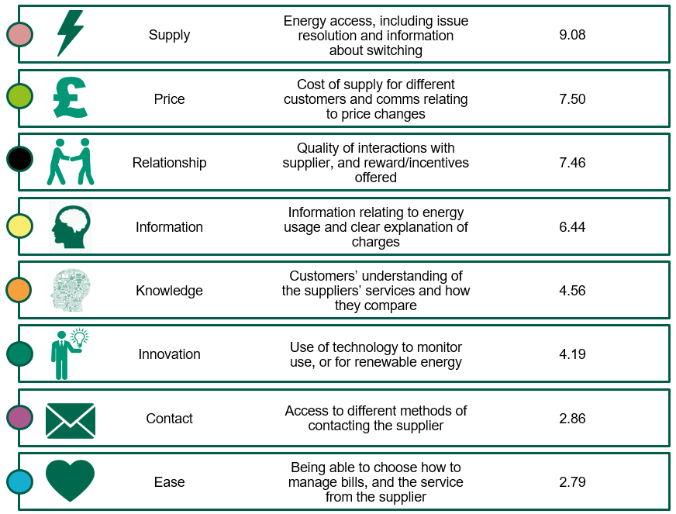
Opportunity scores (by theme)
As a commodity market, it is unsurprising that the strongest opportunities for customer service improvement overall relate to switching, price and deals.
Whilst Supply offers the largest opportunity for improvement overall – this is chiefly driven by provision of information about switching.
Similarly, offering discounted / good prices for loyalty are key elements of Relationship.
Furthermore, being seen to care about customers, and being friendly and helpful present opportunities to energy providers to drive satisfaction.
Opportunity score = The difference between importance and performance
(The highest the score the greatest the opportunity for improved service)
Source: ICS Customer Service in the Energy sector – online survey April 2019.
QIMP: How important or unimportant are each of the following to you when it comes to choosing an energy supplier? / QPER: Now thinking about your current energy supplier, how much do you agree or disagree with the below statements?
Base: Importance; all participants (2063). Performance; all participants with experience of the attribute (1444-1994)
Note: Opportunity scores can take values from -30 to +30, while Importance and Performance range from -10 to +10.

Slide 50
Reduce spend
Overall theme opportunities map
Whilst Supply is the most important theme overall, customers are generally happy with their suppliers’ performance regarding access to energy, and issue resolution.
Overall, improvements to customers’ Relationship with their supplier (especially around rewarding loyalty) and price represent the biggest opportunity for improvement.
Maintain and streamline
Invest and improve
Priority opportunity
Source: ICS Customer Service in the Energy sector – online survey April 2019.
QIMP: How important or unimportant are each of the following to you when it comes to choosing an energy supplier? / QPER: Now thinking about your current energy supplier, how much do you agree or disagree with the below statements?
Base: Importance; all participants (2063). Performance; all participants with experience of the attribute (1444-1994)

Slide 51
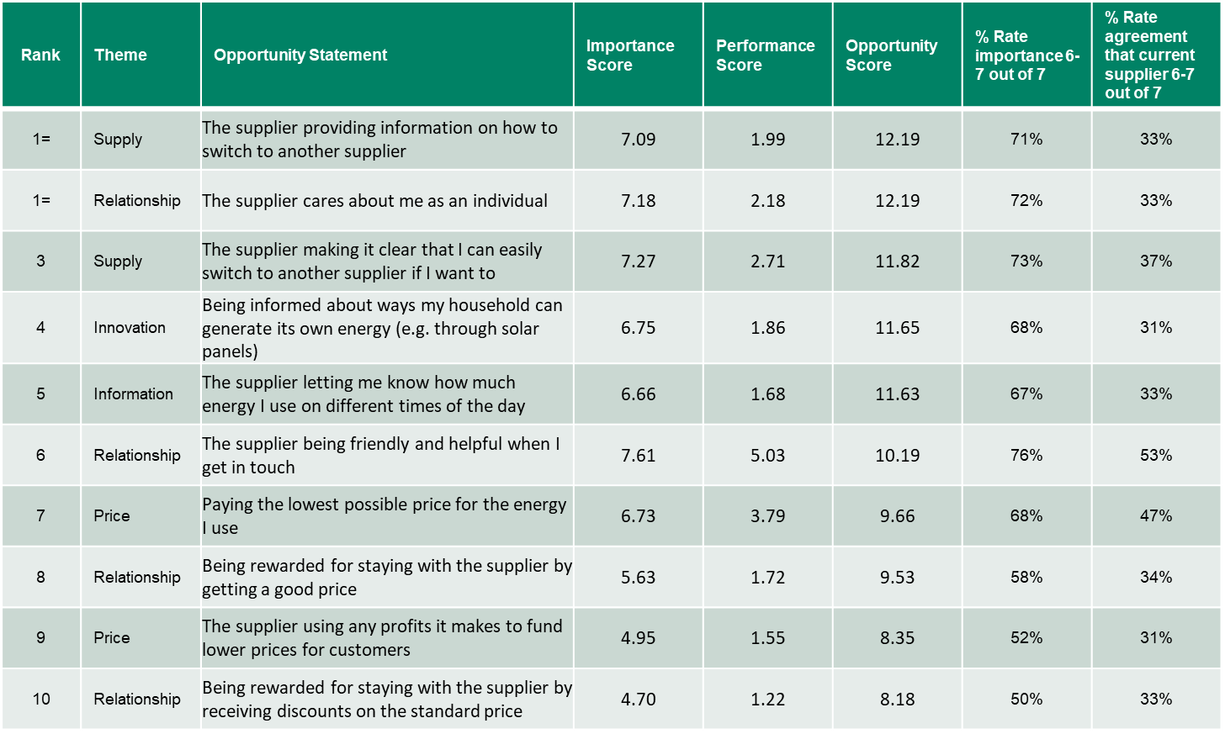
Opportunity Scores
Top 10 Statements
Provision of information on how to switch represents the strongest opportunity overall – this is likely to appeal to switchers, but may also improve perceptions of transparency (part of a suite of attributes relating to customers’ relationship with suppliers, which the drivers analysis identified as having the strongest impact on overall satisfaction).
Beyond price, being seen to care about the customer represents the biggest opportunity for the energy sector, and is again likely to improve the customers’ relationship with their supplier.
Note: Higher opportunity scores represent a greater opportunity to improve service
Source: ICS Customer Service in the Energy sector – online survey April 2019.
QIMP: How important or unimportant are each of the following to you when it comes to choosing an energy supplier? / QPER: Now thinking about your current energy supplier, how much do you agree or disagree with the below statements?
Base: Importance; all participants (2063). Performance; all participants with experience of the attribute (1444-1994)
Note: Opportunity scores can take values from -30 to +30, while Importance and Performance range from -10 to +10.

Slide 52
Supply opportunities
While access to energy, and supply issue resolution is clearly of high importance to customers, they also tend to be happy with their current suppliers’ performance – a testament to the investment and reliability of the network.
Consequently opportunities for improvement in supply relate more to communication of information about switching.
Whilst such communication is likely to appeal to switchers, it would also be likely viewed as a move towards greater openness and transparency.
Reduce spend
Maintain and streamline
3rd
Invest and improve
Joint highest *
Priority opportunity
Source: ICS Customer Service in the Energy sector – online survey April 2019.
QIMP: How important or unimportant are each of the following to you when it comes to choosing an energy supplier? / QPER: Now thinking about your current energy supplier, how much do you agree or disagree with the below statements?
Base: Importance; all participants (2063). Performance; all participants with experience of the attribute (1444-1994)
*Joint highest with “The supplier cares about me as an individual” (relationship theme).
Note: The 10 highest opportunity scores across all 47 statements are highlighted in red.

Slide 53
Reduce spend
Price opportunities
Price was shown to be a key driver of overall satisfaction in the energy sector from the UKCSI data. And all price attributes are of relatively high importance to customers – in particular customers want reassurance that they are paying the lowest price.
Raising awareness of suppliers’ investment in infrastructure – if this could be shown to generate a cost benefit to customers – is also a strong opportunity.
Maintain and streamline
7th
Invest and improve
Priority opportunity
9th
Source: ICS Customer Service in the Energy sector – online survey April 2019.
QIMP: How important or unimportant are each of the following to you when it comes to choosing an energy supplier? / QPER: Now thinking about your current energy supplier, how much do you agree or disagree with the below statements?
Base: Importance; all participants (2063). Performance; all participants with experience of the attribute (1444-1994)
Note: The 10 highest opportunity scores across all 47 statements are highlighted in red.

Slide 54
Relationship opportunities
Attributes relating to supplier relationship are, combined, the strongest overall driver of satisfaction in the energy sector, and likewise those attributes that relate to relationship represent some of the biggest opportunities for improvement.
As was found when interviewed consumers, rewarding loyalty (especially with a discounted price), and treating customers as individuals represent key opportunities for the sector.
Reduce spend
6th
Maintain and streamline
Joint highest*
Invest and improve
8th
Priority opportunity
10th
Source: ICS Customer Service in the Energy sector – online survey April 2019.
QIMP: How important or unimportant are each of the following to you when it comes to choosing an energy supplier? / QPER: Now thinking about your current energy supplier, how much do you agree or disagree with the below statements?
Base: Importance; all participants (2063). Performance; all participants with experience of the attribute (1444-1994)
*Joint highest with “The supplier provides info on how to switch” (supply theme).
Note: The 10 highest opportunity scores across all 47 statements are highlighted in red.

Slide 55
Reduce spend
Maintain and streamline
Information opportunities
Customers value information that enable them to make sense of their bills, and their usage.
Whilst the information on bills and overall usage is felt to be adequate overall – providing a usage breakdown by time of day represents a significant opportunity for the sector.
Invest and improve
5th
Priority opportunity
Source: ICS Customer Service in the Energy sector – online survey April 2019.
QIMP: How important or unimportant are each of the following to you when it comes to choosing an energy supplier? / QPER: Now thinking about your current energy supplier, how much do you agree or disagree with the below statements?
Base: Importance; all participants (2063). Performance; all participants with experience of the attribute (1444-1994)
Note: The 10 highest opportunity scores across all 47 statements are highlighted in red.

Slide 56
Reduce spend
Innovation opportunities
Whilst the majority of innovation statements are viewed as of relatively lower importance, customers are interested in ways in which they might be able to generate their own energy.
This echoes the expert view of a more pluralistic future, and move away from the current “left-to-right” model, but also reflects that innovation needs to be tied to a clear (often cost) benefit to consumers.
Maintain and streamline
4th
Invest and improve
Priority opportunity
Source: ICS Customer Service in the Energy sector – online survey April 2019.
QIMP: How important or unimportant are each of the following to you when it comes to choosing an energy supplier? / QPER: Now thinking about your current energy supplier, how much do you agree or disagree with the below statements?
Base: Importance; all participants (2063). Performance; all participants with experience of the attribute (1444-1994)
Note: The 10 highest opportunity scores across all 47 statements are highlighted in red.

Slide 57
Reduce spend
Knowledge opportunities
Overall energy suppliers appear to be regarded as performing well in the areas which matter most to customers – particularly with regards to clear information on billing.
Suppliers may wish to consider communications to help them understand their offer, and make comparisons – particularly since this is likely to improve transparency ratings; a driver of satisfaction, especially among younger customers.
Maintain and streamline
Invest and improve
Priority opportunity
Source: ICS Customer Service in the Energy sector – online survey April 2019.
QIMP: How important or unimportant are each of the following to you when it comes to choosing an energy supplier? / QPER: Now thinking about your current energy supplier, how much do you agree or disagree with the below statements?
Base: Importance; all participants (2063). Performance; all participants with experience of the attribute (1444-1994)

Slide 58
Reduce spend
Maintain and streamline
Contact opportunities
Phone and email are the most important channels for communication.
Invest and improve
Priority opportunity
Source: ICS Customer Service in the Energy sector – online survey April 2019.
QIMP: How important or unimportant are each of the following to you when it comes to choosing an energy supplier? / QPER: Now thinking about your current energy supplier, how much do you agree or disagree with the below statements?
Base: Importance; all participants (2063). Performance; all participants with experience of the attribute (1444-1994)

Slide 59
Reduce spend
Maintain and streamline
Ease opportunities
Whilst choice (of how you pay, and whether to have a meter) are important to customers – suppliers are rated relatively highly already on these attributes.
Invest and improve
Priority opportunity
Source: ICS Customer Service in the Energy sector – online survey April 2019.
QIMP: How important or unimportant are each of the following to you when it comes to choosing an energy supplier? / QPER: Now thinking about your current energy supplier, how much do you agree or disagree with the below statements?
Base: Importance; all participants (2063). Performance; all participants with experience of the attribute (1444-1994)

Slide 60
Number of times switched energy supplier in past 5 years
On average participants were likely to have switched around once in five years (1.11 times).
More affluent households were, in general, more likely to switch (ABC1: 1.21, C2DE: 0.97)
Switching behaviour
Energy supply is a market with a high degree of customer inertia, with 4 in 10 customers not having switched suppliers in the past 5 years.
However, there is also clearly a small group of consumers who do switch – with 15% having switched supplier 3 or more times in 5 years.
With energy is viewed as a commodity, switching is primarily driven by price/deals – two thirds of switchers say their chief motivation was finding a better deal elsewhere.
Primary reason for switching supplier in the past
Under 45s were significantly less likely to say that “finding a better deal” was their main motivation for switching (52% v 78% among those aged 45+). Customer service* (9% v 6%), and innovation* (11% v 3%) were relatively more important to this age group.
Source: ICS Customer Service in the Energy sector – online survey April 2019.
* “Customer service” represents the net result of combining “Poor customers service” and “Heard good reviews of customer service”. “Innovation” represents the combination of “renewable energy” and “smart meter”.
Q4: With the exception of moving house, how many times, if at all, have you switched energy supplier in the last 5 years?
Base: All participants (2063)
Q5: What is the main reason you have switched suppliers in the past?
Base: Those who have switched in the past 5 years (1171)

Slide 61
Key differences in opportunity scores
Top 10 statements with the biggest difference by Disability in household
Key differences
(by Disability in household)
Customers with a disabled member of the household are more likely to want their supplier to proactively support them (to help them manage payments, reduce their bills, find the best tariff and provide a priority service).
Note: All differences shown are statistically significant
Source: ICS Customer Service in the Energy sector – online survey April 2019.
QIMP: How important or unimportant are each of the following to you when it comes to choosing an energy supplier? / QPER: Now thinking about your current energy supplier, how much do you agree or disagree with the below statements? Opportunity scores calculated.
Base: See chart

Slide 62
(%) Preference of one utilities supplier vs multiple
Preference between one and multiple utility suppliers
Overall customers prefer to access services through different suppliers – and this appear to be primarily driven by a belief that this resulted in a better price.
Nevertheless, 3 in 10 customers prefer the idea of a one-stop shop for utilities, with convenience of management and payment being the key reasons.
Men were significantly more likely to prefer different suppliers (53% v 46%).
Under 45’s, were more likely to prefer the idea of a single solution (41% v 21% for those aged 45+) as were those of non-white ethnicity (40% v 30%)
Source: ICS Customer Service in the Energy sector – online survey April 2019.
Q12: Overall - thinking about all the household needs and utilities (water, energy, pay TV, mobile, broadband) you might have - would you prefer to access these / Q13: Why is that?
Base: Q12: All participants (2063), Q13: Those that preferred one supplier (627), Q13: Those that preferred different suppliers (1019)
Significantly higher, Significantly lower

Slide 63
Preferred method of contacting supplier
Preferred channels for communication
For day to day account management energy customers prefer to use impersonal forms of contact – the website/app when contacting the supplier, and receipt of emails when being contacted.
However, when dealing with an issue (whether supply or billing) there is a clear preference for human interaction, with over half preferring to contact their supplier by phone in these cases. In person communication and web chat are also more likely to be used to deal with issues than for communication of information or account management.
Preferred method of being contacted
Source: ICS Customer Service in the Energy sector – online survey April 2019.
Q9: For each of these reasons, how would you prefer to contact your energy supplier? / Q10. And for each of these reasons, how would you prefer to be contacted by them?
Base: All participants (2063)
Significantly higher, Significantly lower

Slide 64
Spontaneous suggestions for improvements to service
Suggested improvements
When asked for unprompted suggestions for improving service, participants again primarily focus on price.
Source: ICS Customer Service in the Energy sector – online survey April 2019.
Q14. What one thing could your energy supplier do to improve the service they provide to you in general?
Base: All participants (2063)

Slide 65
Appendix 1

Slide 66
The UKCSI: an independent benchmark of customer satisfaction
The UK Customer Satisfaction Index (UKCSI) is a national benchmark of customer satisfaction undertaken and published by The Institute since 2008. The UKCSI is designed to provide an objective, independent perspective of the state of customer satisfaction in the UK. It enables organisations to assess relative strengths and weaknesses compared to others in their sector, and with some of the UK’s leading service organisations across a range of sectors.
The UKCSI is based on customer feedback, gathered via an online panel, on over 200 organisations across 13 sectors. Customers rate their experience of dealing with organisations on a scale of 1 to 10 for over 25 metrics of customer experience. The outputs of this feedback are index scores for an organisation, a sector and for the UK as a whole.
The questions in the UKCSI are based on customers’ priorities – the attributes of customer experience with organisations that are rated as most important by customers. The purpose of this research is to ensure that the UKCSI remains a relevant and essential benchmark of customer satisfaction.
Through in-depth telephone interviews (4 per sector) and online survey responses (200 per sector) customer priorities research:
Ensures that the UKCSI continues to be rooted in relevant and current customer needs and priorities
Ensures that the UKCSI continues to reflect and measure both customers’ transactional and relationship needs
Maintain a consistent and robust set of customer experience benchmark measures
Customer Priorities
UKCSI research
Source: ICS Customer Service in the Energy sector – Desk based research, April 2019.
The Institute of Customer Service report “Experiences, Emotions and Ethics. Refreshing the customer priorities that underpin the UK Customer Satisfaction Index”

Slide 67
UK Customer Priorities

Slide 68



13 sectors in both 2015 & 2019:
Automotive
Banks & Building Societies
Insurance
Leisure
Public Services (Local)
Public Services (National)
Retail (Food)
Retail (non-food)
Services
Telecommunications & Media
Tourism
Transport
Utilities
Average age is 47 & 48 years in 2015 and in 2019 respectively (age ranges from 18 to 86)
9% (2015 & 2019) live in Scotland
2% (2015) & 3% (2019) live in Northern Ireland
UK Customer Priorities research
Demographics
All sectors
2015 & 2019
45% (2015) & 49% (2019) are males
55% (2015) & 52% (2019) are females
26% (2015) & 24% (2019) live in Northern England
18% (2015) & 16% (2019) live in Central England
5% (2015 & 2019) live in Wales
33% (2015) & 36% (2019) live in South East England
7% (2015 & 2019) live in South West England
Utilities sector:
66% (2015) & 61% (2019) Energy
28% (2015) & 34% (2019) Water
7% (2015) & 5% (2019) Other
85% (2015) & 78% (2019) use one of the
Big 6 Energy suppliers
15% (2015) & 22% (2019) use
Other Energy suppliers
Source: ICS Customer Service in the Energy sector – Desk based research, April 2019.
Base: UK Customer Priorities Data July 2015 & January 2019 (UK All sector average n=3120 & 2600 respectively).

Slide 69
How important or unimportant each of the following factors are to you?
July 2015 & January 2019
Mean importance scores top 10 factors (scale 1-10)
Utilities sector
Utilities
Apart from product/ supply reliability, which is a key factor, consumers place emphasis on the interaction with the supplier’s staff. Competent employees, who understand the issue and keep promises on what they say they will do in terms of complaints is key.
Source: ICS Customer Service in the Energy sector – Desk based research, April 2019.
Base: UK Customer Priorities Data Utilities sector (July 2015 n=240, January 2019 n=200).
Significantly higher when compared to the UK All sector average, Significantly lower when compared to the UK All sector average
*Unique per wave attribute; was not asked in 2015.

Slide 70
How important or unimportant each of the following factors are to you?
July 2015 & January 2019
Mean importance scores top 10 factors (scale 1-10)
Water sector
Water
Product/service quality and reliability has remained important within the water sector.
Speed of response has become relatively more important in 2019, whereas website navigation has decreased in importance
Source: ICS Customer Service in the Energy sector – Desk based research, April 2019.
Base: UK Customer Priorities Data Water sector (July 2015 n=66, January 2019 n=68).
Significantly higher when compared to the UK All sector average, Significantly lower when compared to the UK All sector average
*Unique per wave attribute.

Slide 71
How important or unimportant each of the following factors are to you?
July 2015 & January 2019
Mean importance scores top 5 factors (scale 1-10)
Banks & Building Societies sector
Banks & Building Societies
Compared to Utilities, consumers place greater importance on staff competency and choice of channels
Source: ICS Customer Service in the Energy sector – Desk based research, April 2019.
Base: UK Customer Priorities Data Banks & Building Societies sector (July 2015 n=240, January 2019 n=200).
Significantly higher when compared to the UK All sector average, Significantly lower when compared to the UK All sector average
*Unique per wave attribute.

Slide 72
How important or unimportant each of the following factors are to you?
July 2015 & January 2019
Mean importance scores top 5 factors (scale 1-10)
Insurance sector
Insurance
Competence and helpfulness of staff feature among the top 3 priorities in 2015, while staff keeping promises when it comes to complaints, product/ service reliability and quality are among the top 3 important factors in 2019.
Source: ICS Customer Service in the Energy sector – Desk based research, April 2019.
Base: UK Customer Priorities Data Insurance sector (July 2015 n=240, January 2019 n=200).
Significantly higher when compared to the UK All sector average, Significantly lower when compared to the UK All sector average

Slide 73
How important or unimportant each of the following factors are to you?
July 2015 & January 2019
Mean importance scores top 5 factors (scale 1-10)
Telecommunications & Media sector
Telecommunications & Media
Competency of staff and product/service reliability are among the top 5 priorities in the Telecommunications and Media sector, however the order of these attributes has shifted between the two waves.
Source: ICS Customer Service in the Energy sector – Desk based research, April 2019.
Base: UK Customer Priorities Data Telecommunications & Media sector (July 2015 n=240, January 2019 n=200).
*Unique per wave attribute.

Slide 74
How important or unimportant each of the following factors are to you?
Mean importance scores top 10 factors (scale 1-10)
Big 6 Energy suppliers
Consumers who used one of the Big 6 suppliers tend to place higher importance on customer service components than the overall Energy sector in July 2016. Keeping promises and handling complaints quickly were key factors.
In 2019, the top 10 factors are slightly less important for Big 6 customers compared to the Energy sector overall. Product/ service reliability and quality as well as staff being able to deliver what they have promised to the customer are chief attributes.
Source: ICS Customer Service in the Energy sector – Desk based research, April 2019.
Base: UK Customer Priorities Data Energy sector (July 2015 - Big 6 n=135, All Energy n=158, January 2019 – Big 6 n=95, All Energy n=122). *Unique per wave attribute.

Slide 75
How important or unimportant each of the following factors are to you?
Mean importance scores top 5 factors (scale 1-10)
Energy by gender
In most cases, female consumers gave higher scores for the factors’ importance than male individuals compared to the Energy sector in both Customer Priorities waves.
In 2015, complaint handling is key for females, while product reliability is the chief factor among males.
In 2019, condition of delivered goods and product/ service reliability are significantly more likely to be important factors for female consumers, while for males the product reliability and quality are among the top 2 attributes.
Source: ICS Customer Service in the Energy sector – Desk based research, April 2019.
Base: UK Customer Priorities Data Energy sector (July 2015 - Female n=85, Male n=73, All Energy n=158, January 2019 – Female n=67, Male n=55, All Energy n=122).
Significantly higher when compared to the UK All sector average, Significantly lower when compared to the UK All sector average
*Unique per wave attribute.

Slide 76
How important or unimportant each of the following factors are to you?
Mean importance scores top 5 factors (scale 1-10)
Energy by age
July 2015
Apart from competence of staff and being treated as a valued customer, speed of response by webchat and by email feature among the top 5 factors for under 36-year-olds.
Complaint related factors are key for 35 to 45 year-old Energy consumers.
Older consumers are significantly more likely to give higher scores for product reliability, the outcome of the complaint, price and staff doing what they have promised to do.
Source: ICS Customer Service in the Energy sector – Desk based research, April 2019.
Base: UK Customer Priorities Data Energy sector (July 2015 – 18-34 n=41, 35-54 n=63, 55 or older n=54, All Energy n=158).
Significantly higher when compared to the UK All sector average, Significantly lower when compared to the UK All sector average
*Unique per wave attribute.

Slide 77
How important or unimportant each of the following factors are to you?
Mean importance scores top 5 factors (scale 1-10)
Energy by age
January 2019
Product/ service quality and reliability lie among the top 5 important factors across all age groups, however 55 years old or older consumers are significantly more likely to consider reliability as an important attribute when compared to All sector average.
The new factor ease of using the website is unsurprisingly in the top 5 list of the younger population, although the scores is less than the sector average.
Source: ICS Customer Service in the Energy sector – Desk based research, April 2019.
Base: UK Customer Priorities Data Energy sector (January 2019 – 18-34 n=36, 35-54 n=52, 55 or older n=34, All Energy n=122).
Significantly higher when compared to the UK All sector average, Significantly lower when compared to the UK All sector average
*Unique per wave attribute.

Slide 78
How important or unimportant each of the following factors are to you?
Mean importance scores top 10 factors (scale 1-10)
Channels used to contact the Energy supplier
July 2015
More than one third of Energy consumers mainly used supplier’s website to deal with them, while nearly three in eight consumers mainly dealt with the provider via phone.
Website users rated complaint related factors (top 6) higher than the sector average. Competence, helpfulness of staff and staff doing what they say they will do are key for those consumers who mainly used the phone to deal with their energy supplier.
Source: ICS Customer Service in the Energy sector – Desk based research, April 2019.
Base: UK Customer Priorities Data Energy sector (July 2015 - Website n=53, Phone n=59, All Energy n=158).
Note: The base is very small for the other channels to be reported.
*Unique per wave attribute.

Slide 79
How important or unimportant each of the following factors are to you?
Mean importance scores top 10 factors (scale 1-10)
Channels used to contact the Energy supplier
January 2019
More than half of the Energy consumers have used supplier’s website during their most recent contact with them, while less than one third have dealt with the supplier via phone.
Product/ service reliability is the number one factor for both website and phone users in 2019. Complaint handling is significantly more likely to be valued by website users in the energy sector when compared to the UK all sector average.
Source: ICS Customer Service in the Energy sector – Desk based research, April 2019.
Base: UK Customer Priorities Data Energy sector (January 2019 - Website n=62, Phone n=36, All Energy n=122). Note: The base is very small for the other channels to be reported.
Significantly higher when compared to the UK All sector average, Significantly lower when compared to the UK All sector average
*Unique per wave attribute.

Slide 80
Reasons for contacting the Energy supplier
July 2015
The most common activity for energy consumers is to check their account information, followed by asking a question when dealt with their supplier in 2015 data.
Competence of staff, the outcome of the complaint, webchat’s response speed and check-out process are significantly more important factors for those who checked their account information.
Condition of delivered goods, speed of resolving the complaint and being able to interact with the supplier in any way it is preferred are the top 3 factors for those who contacted their energy supplier to ask a question.
How important or unimportant each of the following factors are to you?
Mean importance scores top 10 factors (scale 1-10)
Source: ICS Customer Service in the Energy sector – Desk based research, April 2019.
Base: UK Customer Priorities Data Energy sector (July 2015 - Checking your account information/receiving a regular account statement or bill n=58, Enquiry/asking a question n=34, All Energy n=158). Note: The base is very small for the other reasons to be reported.
Significantly higher when compared to the UK All sector average, Significantly lower when compared to the UK All sector average
*Unique per wave attribute.

Slide 81
 |  | Energy
1 | Product/service reliability | 8.36
2 | Product/service quality | 8.29
3 | Staff doing what they say they will do (complaints) | 8.22
4 | The attitude of staff (complaints) | 8.16
5 | Ease of dealing with XX | 8.16
6 | Ease of using the website* | 8.13
7 | Handling of enquiries | 8.12
8 | Ability to interact with XX in the way you prefer | 8.12
9 | Condition of delivered goods | 8.10
10 | Staff listen to you* | 8.08
11 | Staff understanding the issue (complaints) | 8.08
12 | Cares about their customers | 8.08
13 | Price/cost | 8.08
14 | Competence of staff | 8.06
15 | Quality of information/advice | 8.05
16 | Open and transparent | 8.03
17 | Availability of support (online) | 8.02
18 | XX explains information clearly* | 8.02
19 | The outcome of the complaint | 8.00
20 | On time delivery | 7.99
21 | XX keeps their promises* | 7.98
 |  | Energy
22 | Billing | 7.98
23 | XX puts customers first* | 7.98
24 | Speed of service/response | 7.97
25 | XX makes it easy to contact the right person to help* | 7.97
26 | Helpfulness of staff | 7.97
27 | Being kept informed | 7.94
28 | XX makes your life easier* | 7.93
29 | The handling of the complaint | 7.91
30 | Reputation of the organisation | 7.88
31 | Speed of resolving your complaint | 7.86
32 | The check-out process (online) | 7.85
33 | You trust XX | 7.85
34 | XX are on the side of the customer* | 7.84
35 | The ease of getting through (phone) | 7.84
36 | XX consistently meets my expectations* | 7.83
37 | XX designs the experience around its customers* | 7.82
38 | XX makes you feel reassured* | 7.81
39 | Product/service range | 7.75
40 | XX does the right thing in business practices (for example for its employees and for society)* | 7.69
41 | XX makes you feel valued | 7.66
Mean importance scores - all 41 attributes
January 2019
Source: ICS Customer Service in the Energy sector – Desk based research, April 2019.
Base: UK Customer Priorities Data Energy sector (January 2019 Energy n=122).
Q: How important or unimportant each of the following factors are to you? Mean importance scores (scale 1-10)
*Unique per wave attribute; was not asked in 2015.

Slide 82
 |  | Energy
1 | Staff doing what they say they will do (complaints) | 8.39
2 | The outcome of the complaint | 8.34
3 | The handling of the complaint | 8.33
4 | Product reliability | 8.32
5 | Competence of staff (in person) | 8.31
6 | Competence of staff (phone) | 8.30
7 | Helpfulness of staff (phone) | 8.30
8 | Staff understanding the issue (complaints) | 8.30
9 | Speed of resolving your complaint | 8.30
10 | The attitude of staff (complaints) | 8.29
11 | Price/cost | 8.25
12 | Helpfulness of staff (in person) | 8.24
13 | Ease of getting through (phone) | 8.23
14 | Value for money* | 8.22
15 | Speed of response by email | 8.20
16 | Ease of finding what you want (website)* | 8.19
17 | Provision of useful information (website)* | 8.13
18 | The check-out process (website) | 8.11
19 | You trust XX | 8.09
20 | Ease of doing business | 8.06
21 | Ability to interact with XX in the way you prefer | 8.05
22 | Speed of service (in person) | 8.04
23 | Speed of response by text | 8.04
 |  | Energy
24 | Friendliness of staff (in person)* | 8.03
25 | Handling of enquiries | 8.03
26 | Availability of support (website) | 8.00
27 | Billing | 8.00
28 | Condition of delivered goods | 7.99
29 | Speed of response by web chat | 7.98
30 | Understanding your needs as a customer* | 7.98
31 | On time delivery | 7.97
32 | Product/service quality | 7.97
33 | Being kept informed | 7.95
34 | Being treated as a valued customer | 7.92
35 | Quality of information/advice | 7.84
36 | Reputation of the organisation | 7.83
37 | Cares about their customers | 7.79
38 | Open and transparent | 7.75
39 | Speed of response by letter | 7.68
40 | Cares about their employees* | 7.68
41 | Employees of XX want to 'go the extra mile‘* | 7.61
42 | Product/service range | 7.60
43 | Speed of response by social media | 7.53
44 | Personalise their service to meet your needs* | 7.52
45 | Contributes to the local and/or UK economy* | 7.40
46 | Is an innovative organisation* | 7.28
47 | Involves me in developing new products and services* | 7.14
Mean importance scores - all 47 attributes
July 2015
Source: ICS Customer Service in the Energy sector – Desk based research, April 2019.
Base: UK Customer Priorities Data Energy sector (July 2015 Energy n=158).
Q: How important or unimportant each of the following factors are to you? Mean importance scores (scale 1-10)
*Unique per wave attribute; was not asked in 2019.

Slide 83
UKCSI drivers’ analysis

Slide 84
Sample structure
The sample collected for the survey broadly reflects the proportions within the general population overall, although there is a slight skew towards the South of England over the Midlands/Wales.
Across all sectors (55000)
Gender
Region
Age
Rating Energy suppliers (15105)
Gender
Region
Age
Source: ICS Customer Service in the Energy sector – Desk based research, April 2019.
Q27: What is your gender?
Base: UKCSI Data Jan 2016 – Jan 2019

Slide 85
Opportunity map for energy sector
(key theme averages)
Competence*
Helpfulness*
Ability to interact in the way you prefer
Ease of doing business
Quality of information/ advice
Handling of enquiries
Speed of response*
Billing
Being kept informed
Opportunity map
Satisfaction with energy suppliers is mainly driven by the relationship with the supplier, and price. However, given this is a ‘low-touch’ industry, it is vital that the few interactions a customer has with their supplier are straightforward.
Reliable supply is seen as an expected service but does not have as strong impact on satisfaction ratings as relationship, communication and price.
Although energy suppliers’ complaint handling tended to be rated somewhat lower than other measures, this had a relatively low impact on overall customer satisfaction.
Product reliability
Product/ service quality
On time delivery*
Condition of goods*
Reduce spend
Maintain and streamline
Reputation of the organisation
You trust the organisation
Cares about their customers
Open and transparent
Invest and improve
The handling of the complaint
Speed of resolving your complaint
Staff doing what they say they will do
The outcome of the complaint
The attitude of staff
Staff understanding the issue
Priority opportunity
* Attributes represent combined scores across different channels
Source: ICS Customer Service in the Energy sector – Desk based research, April 2019.
Q2: We would like to know how satisfied or dissatisfied you are with XX by asking you to score the list of factors below. So thinking about your last experience of XX, what score would you give for: / Q3: How satisfied or dissatisfied are you with XX overall?
Drivers analysis (Relative importance). Overall satisfaction as dependent variable.
Base: UKCSI Data Jan 2016 – Jul 2018. Ratings of energy suppliers only. (13190)

Slide 86
Opportunity map for energy sector
Relationship
Price
Communication
Product/Service
Complaint handling
Reduce spend
Maintain and streamline
Opportunity map
Reputation, trust, care and transparency are key drivers of satisfaction with the energy supplier.
Invest and improve
Priority opportunity
Among those who had experienced a problem in the past 3 months, obtaining a satisfactory outcome had the biggest impact with regards complaint handling (relationship and price were still more important).
* Attributes represent combined scores across different channels
Source: ICS Customer Service in the Energy sector – Desk based research, April 2019.
Q2: We would like to know how satisfied or dissatisfied you are with XX by asking you to score the list of factors below. So thinking about your last experience of XX, what score would you give for: / Q3: How satisfied or dissatisfied are you with XX overall?
Drivers analysis (Relative importance). Overall satisfaction as dependent variable.
Base: UKCSI Data Jan 2016 – Jul 2018. Ratings of energy suppliers only. (13190)

Slide 87
Overall satisfaction – by tenure
Mean satisfaction scores (Scale 1-10)
Satisfaction with energy supplier
(By tenure)
Satisfaction with energy supplier tended to increase with tenure.
The first year of the relationship is clearly a crucial time – with likely increased interaction with the supplier at this stage.
Source: ICS Customer Service in the Energy sector – Desk based research, April 2019.
Q3. How satisfied or dissatisfied are you with XX overall? / Q25: How long have you been using XX?
Base: UKCSI Data Jan 2016 – Jan 2019. Ratings of energy suppliers only. (See chart)
Significantly higher, Significantly lower

Slide 88
Drivers analysis: Attributes’ relative importance for overall satisfaction
By tenure
Drivers analysis
(Relative importance by tenure)
Those early into their tenure tended to place greater importance on quality of information and enquiry handling.
Importance placed on customers’ relationship with their supplier (i.e. reputation, trust and transparency) increased with tenure.
Source: ICS Customer Service in the Energy sector – Desk based research, April 2019.
Q2: We would like to know how satisfied or dissatisfied you are with XX by asking you to score the list of factors below. So thinking about your last experience of XX, what score would you give for: / Q3: How satisfied or dissatisfied are you with XX overall?
Drivers analysis (Relative importance). Overall satisfaction as dependent variable.
Base: UKCSI Data Jan 2016 – Jul 2018. Ratings of energy suppliers only. (See chart)

Slide 89
Overall satisfaction – by demographics
Mean satisfaction scores (Scale 1-10)
Satisfaction with energy supplier
(By demographics)
Women, older customers and those with a disabled person living in the household tended to rate their satisfaction with their energy supplier slightly higher overall.
Source: ICS Customer Service in the Energy sector – Desk based research, April 2019.
Q3: How satisfied or dissatisfied are you with XX overall? / Q27: What is your gender? / Q26: Do you have a disability or long term health condition?
Base: UKCSI Data Jan 2016 – Jul 2018. Ratings of energy suppliers only.
Significantly higher, Significantly lower

Slide 90
Drivers analysis: Attributes’ relative importance for overall satisfaction
By demographics
Drivers analysis
Perceptions of openness and transparency had a greater impact on satisfaction ratings amongst men, and the under 45s.
Older customers placed slightly greater importance on brand trust, and the belief that the supplier cares for its customers.
Price/cost had less impact on satisfaction ratings among those with a disabled person in the household.
Source: ICS Customer Service in the Energy sector – Desk based research, April 2019.
Q2: We would like to know how satisfied or dissatisfied you are with XX by asking you to score the list of factors below. So thinking about your last experience of XX, what score would you give for: / Q3: How satisfied or dissatisfied are you with XX overall?
Drivers analysis (Relative importance). Overall satisfaction as dependent variable.
Base: UKCSI Data Jan 2016 – Jul 2018. Ratings of energy suppliers only. (See chart)

Slide 91
Overall satisfaction – by channel
Mean satisfaction scores (Scale 1-10)
Satisfaction with energy supplier
(By most recent channel)
Overall satisfaction with supplier was significantly higher amongst those that had had face to face interaction with their supplier.
In contrast customers who had most recently communicated by phone tended to rate their satisfaction significantly lower than the average – suggesting that call centres are failing to provide the same sort of “human touch” that face to face offers
NB: Customers meeting in person, and customers calling by phone, were each broadly as likely to had a problem in the past 3 months – so this would not account for the difference:
- In person: 20%
- By phone: 18%
Direct staff interaction
Written
Digital
Source: ICS Customer Service in the Energy sector – Desk based research, April 2019.
Q1a: Thinking about your most recent contact with XX, did you deal with them… / Q3: How satisfied or dissatisfied are you with XX overall?
Base: UKCSI Data Jan 2016 – Jan 2019. Ratings of energy suppliers only. (See chart)
Significantly higher, Significantly lower

Slide 92
Drivers analysis: Attributes’ relative importance for overall satisfaction
By channel
Drivers analysis
(Relative importance by most recent channel)
Speed of response had a significantly larger impact on satisfaction with the organisation amongst those who chose web chat, text or social media suggesting that their expectations are a more immediate response. Reputation of the supplier was also more important for these participants.
Those who had most recently interacted by phone were more likely to be influenced by measures relating to enquiry handling than other channels (quality of information, ease of doing business, etc).
Direct staff interaction
Written
Digital
Source: ICS Customer Service in the Energy sector – Desk based research, April 2019.
Q2: We would like to know how satisfied or dissatisfied you are with XX by asking you to score the list of factors below. So thinking about your last experience of XX, what score would you give for: / Q3: How satisfied or dissatisfied are you with XX overall?
Drivers analysis (Relative importance). Overall satisfaction as dependent variable.
Base: UKCSI Data Jan 2016 – Jul 2018. Ratings of energy suppliers only. (See chart)

Slide 93
Overall satisfaction – by supplier profile
Mean satisfaction scores (Scale 1-10)
Satisfaction with energy supplier
(By supplier profile)
Customers’ satisfaction with energy companies outside of the big 6 tended to be somewhat higher - this may reflect the fact that customers have chosen these suppliers in order to address a specific need.
Those that had ever experienced a problem tended to rate their supplier substantially less positively. Whilst complaint handling was not found to be a strong driver of satisfaction overall, complaints are clearly a key touchpoint.
Source: ICS Customer Service in the Energy sector – Desk based research, April 2019.
Q3: How satisfied or dissatisfied are you with XX overall?
Base: UKCSI Data Jan 2016 – Jan 2019. Ratings of energy suppliers only. (See chart)
Significantly higher, Significantly lower

Slide 94
Drivers analysis: Attributes’ relative importance for overall satisfaction
By supplier profile
Drivers analysis
(Relative importance by supplier profile)
The key drivers of satisfaction amongst those that had experienced a problem were broadly the same as other customers.
Brand reputation had a bigger impact on satisfaction ratings among those using suppliers other than the Big 6.
Source: ICS Customer Service in the Energy sector – Desk based research, April 2019.
Q2: We would like to know how satisfied or dissatisfied you are with XX by asking you to score the list of factors below. So thinking about your last experience of XX, what score would you give for: / Q3: How satisfied or dissatisfied are you with XX overall?
Drivers analysis (Relative importance). Overall satisfaction as dependent variable.
Base: UKCSI Data Jan 2016 – Jul 2018. Ratings of energy suppliers only. (See chart)

Slide 95
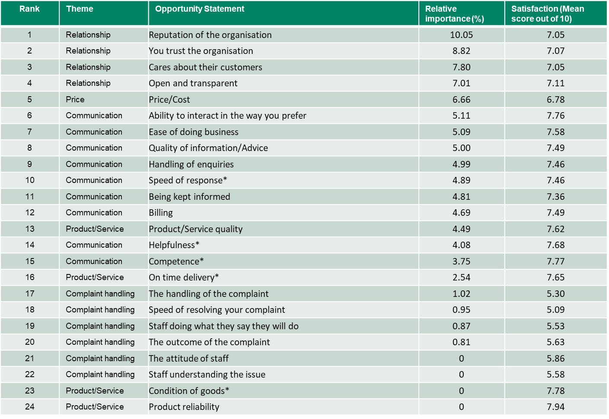
Drivers analysis
Relative importance of attributes
* Attributes represent combined scores across different channels
Source: ICS Customer Service in the Energy sector – Desk based research, April 2019.
Q2: We would like to know how satisfied or dissatisfied you are with XX by asking you to score the list of factors below. So thinking about your last experience of XX, what score would you give for: / Q3: How satisfied or dissatisfied are you with XX overall?
Drivers analysis (Relative importance). Overall satisfaction as dependent variable.
Base: UKCSI Data Jan 2016 – Jul 2018. Ratings of energy suppliers only. (13910)

Slide 96
UKCSI questions asked in July 2016 only
Energy sector
Energy related questions asked in July 2016
Price and deals are the main drivers to choose energy supplier while nearly three quarters of consumers buy both electricity and gas from a single supplier.
In terms of switching, the consumer inertia is also present in July’s 2016 data, with three in seven consumers saying that they have not switched their energy supplier within the last 5 years.
Source: ICS Customer Service in the Energy sector – Desk based research, April 2019.
Base: UKCSI Data Energy sector (July 2016 n=3376).

Slide 97
Quantitative phase

Slide 98



Consumer themes brought forward to the quant
The original 6 themes from the qual were refined to become 8.
Information
Providing breakdowns of usage, and clearly explaining charges
Price
Cost of energy supply, and how charges are communicated to customers
Knowledge
Customers’ understanding of their suppliers’ services
Supply
Energy access, and resolution of supply issues
Innovation
Technology to monitor usage or renewable energy
Relationship
Positive interactions with customers, and rewards to promote loyalty
Contact
Able to contact the supplier via the customer’s preferred channel
Ease
Able to choose whether to be metered or pay fixed amounts
Source: ICS Customer Service in the Energy sector – online survey April 2019.

Slide 99
Sample structure
The sample collected for the survey broadly reflects the national average, though with a slight skew towards the more affluent.
Gender
Region
Age
Social Grade
Ethnicity
Disability in household
Housing type
Housing status
S2: Which of the following areas do you live in…? / S5: Which, if any, of the following terms best describes your gender? / S6: Please select which best describes your ethnic group or background. / D7 :Do you, or anyone in your household, have any long-term illness, physical or mental health problem or disability which limits your daily activities or the work you can do? / D8: And would you say you / your household member’s daily activities are limited a little or a lot? / D9: What type of accommodation does your household occupy? / D10: And do you…?
Base: All participants (2063)
Source: ICS Customer Service in the Energy sector – online survey April 2019.

Slide 100
Energy supply
Current supplier
Energy supply
The majority of energy customers source their gas and electricity from the same supplier.
British Gas is the main energy supplier, supplying a quarter of customers overall.
Almost a third of customers had a prepayment meter (though it was significantly more common among the under 45s (48%), non-white ethnic groups (52%) and C2DEs (39%).
Smart meters were present in two fifths of homes, being slightly more common for electricity than gas. Again, under 45s (54%) and non-white groups (55%) were more likely to have these installed.
31%
43%
Use a prepayment meter
24% for gas
24% for electricity
Use a smart meter
32% for gas
39% for electricity
Source: ICS Customer Service in the Energy sector – online survey April 2019.
Q1: Please select your energy supply in your household / Q2: Do you buy electricity and gas from the same supplier? / Q3: Which energy provider do you use? / Q7. Does your household use a pre-payment meter for your [energy supply]? / Q8. Please look at the description of what a smart energy meter does and then answer the question that follows.
Base: All participants (2063)

Slide 101
Likely triggers for switching
Triggers for switching
Further supporting the idea that energy is viewed as a commodity, over half of all energy customers considered “finding a better deal” a trigger for switching.
In contrast, customer service, innovation, and even supply issues were unlikely to be considered triggers to leave the supplier.
And more than one in ten energy customers believed they would never leave their supplier, even when prompted with potential issues.
Again, younger customers were less motivated by price/deals (Under 45s: 48%, Aged 45+: 60%), and considered themselves somewhat more likely to switch due to technology / innovation (Under 45s: 8%, Aged 45+: 3%)
Older customers were significantly more likely to want to stay with their supplier (Under 45s: 8%, Aged 45+: 14%).
Source: ICS Customer Service in the Energy sector – online survey April 2019.
Q6. What if anything would make you switch from your current energy supplier?
Base: All participants (2063)

Slide 102
Key differences in opportunity scores
Top 10 statements with the biggest difference by Gender
Key differences
(by Gender)
Women appeared to value a more proactive approach from their energy supplier than men, with higher opportunity scores for the supplier getting in touch regarding unusual patterns, explaining how to reduce bills and helping to manage payments.
Note: All differences shown are statistically significant
Source: ICS Customer Service in the Energy sector – online survey April 2019.
QIMP: How important or unimportant are each of the following to you when it comes to choosing an energy supplier? / QPER: Now thinking about your current energy supplier, how much do you agree or disagree with the below statements? Opportunity scores calculated
Base: See chart

Slide 103
Key differences in opportunity scores
Top 10 statements with the biggest difference by Age group
Key differences
(by Age group)
Older customers placed greater importance on being rewarded for loyalty with a good or discounted price.
Note: All differences shown are statistically significant
Source: ICS Customer Service in the Energy sector – online survey April 2019.
QIMP: How important or unimportant are each of the following to you when it comes to choosing an energy supplier? / QPER: Now thinking about your current energy supplier, how much do you agree or disagree with the below statements? Opportunity scores calculated
Base: See chart

Slide 104
Key differences in opportunity scores
Top 10 statements with the biggest difference by Ethnicity
Key differences
(by Ethnicity)
Customers with a white ethnic background tended to be more price conscious than non-white.
Being able to manage their account by phone (text or app) represented a relatively greater opportunity for those with a non-white background.
Note: All differences shown are statistically significant
Source: ICS Customer Service in the Energy sector – online survey April 2019.
QIMP: How important or unimportant are each of the following to you when it comes to choosing an energy supplier? / QPER: Now thinking about your current energy supplier, how much do you agree or disagree with the below statements? Opportunity scores calculated
Base: See chart

Slide 105
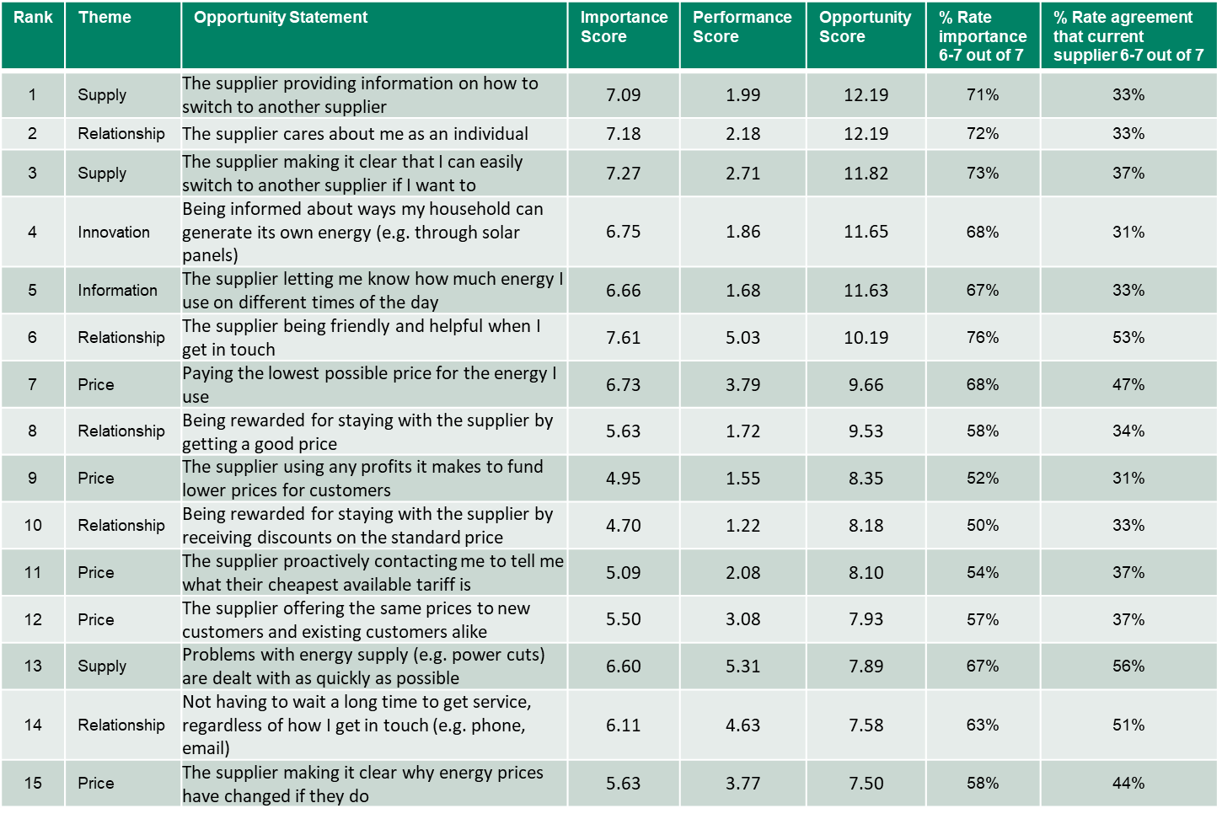
Opportunity Scores
Note: Higher opportunity scores represent greater opportunity to improve service
Source: ICS Customer Service in the Energy sector – online survey April 2019.
QIMP: How important or unimportant are each of the following to you when it comes to choosing an energy supplier? / QPER: Now thinking about your current energy supplier, how much do you agree or disagree with the below statements?
Base: Importance; all participants (2063). Performance; all participants with experience of the attribute (1444-1994)

Slide 106
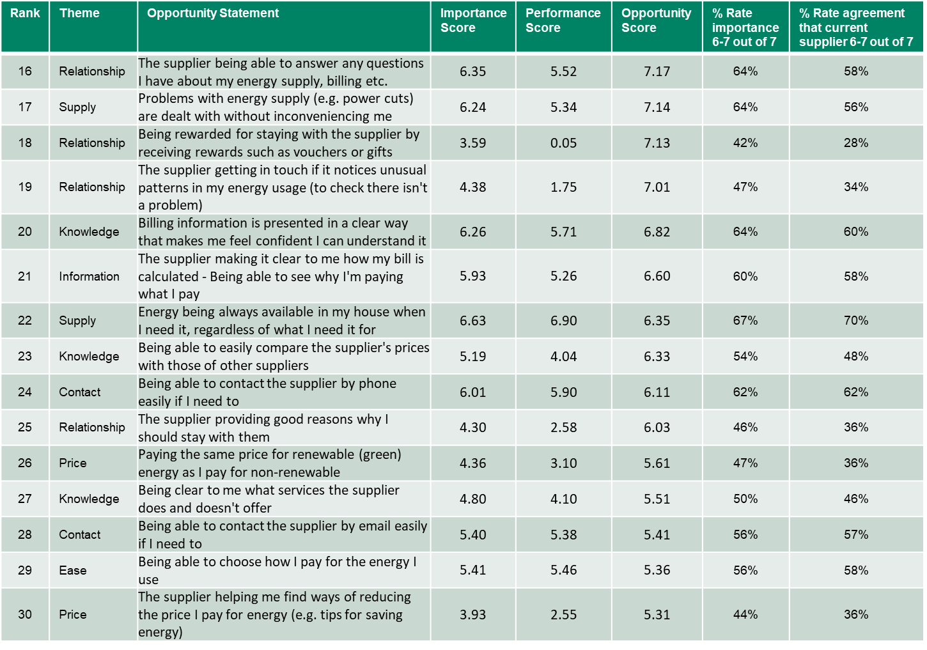
Opportunity Scores
Note: Higher opportunity scores represent greater opportunity to improve service
Source: ICS Customer Service in the Energy sector – online survey April 2019.
QIMP: How important or unimportant are each of the following to you when it comes to choosing an energy supplier? / QPER: Now thinking about your current energy supplier, how much do you agree or disagree with the below statements?
Base: Importance; all participants (2063). Performance; all participants with experience of the attribute (1444-1994)

Slide 107
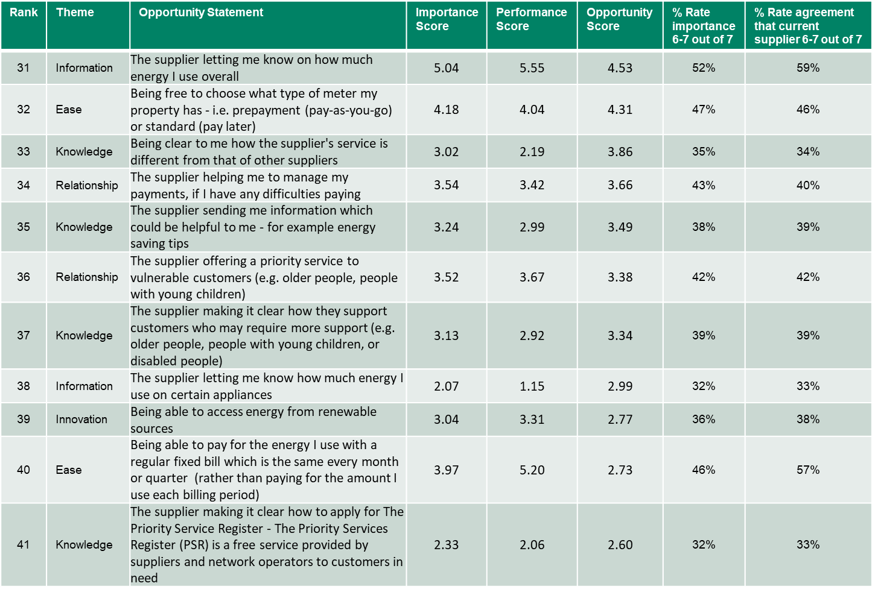
Opportunity Scores
Note: Higher opportunity scores represent greater opportunity to improve service
Source: ICS Customer Service in the Energy sector – online survey April 2019.
QIMP: How important or unimportant are each of the following to you when it comes to choosing an energy supplier? / QPER: Now thinking about your current energy supplier, how much do you agree or disagree with the below statements?
Base: Importance; all participants (2063). Performance; all participants with experience of the attribute (1444-1994)

Slide 108
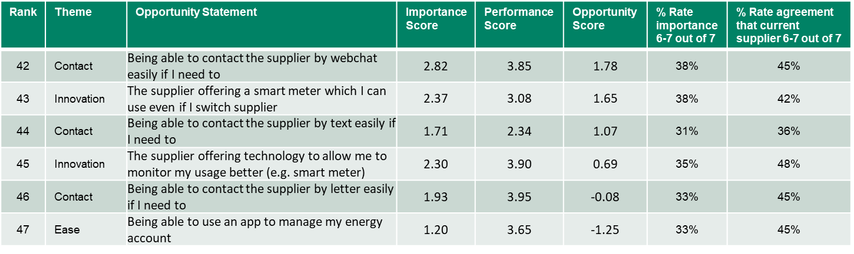
Opportunity Scores
Note: Higher opportunity scores represent greater opportunity to improve service
Source: ICS Customer Service in the Energy sector – online survey April 2019.
QIMP: How important or unimportant are each of the following to you when it comes to choosing an energy supplier? / QPER: Now thinking about your current energy supplier, how much do you agree or disagree with the below statements?
Base: Importance; all participants (2063). Performance; all participants with experience of the attribute (1444-1994)

Slide 109
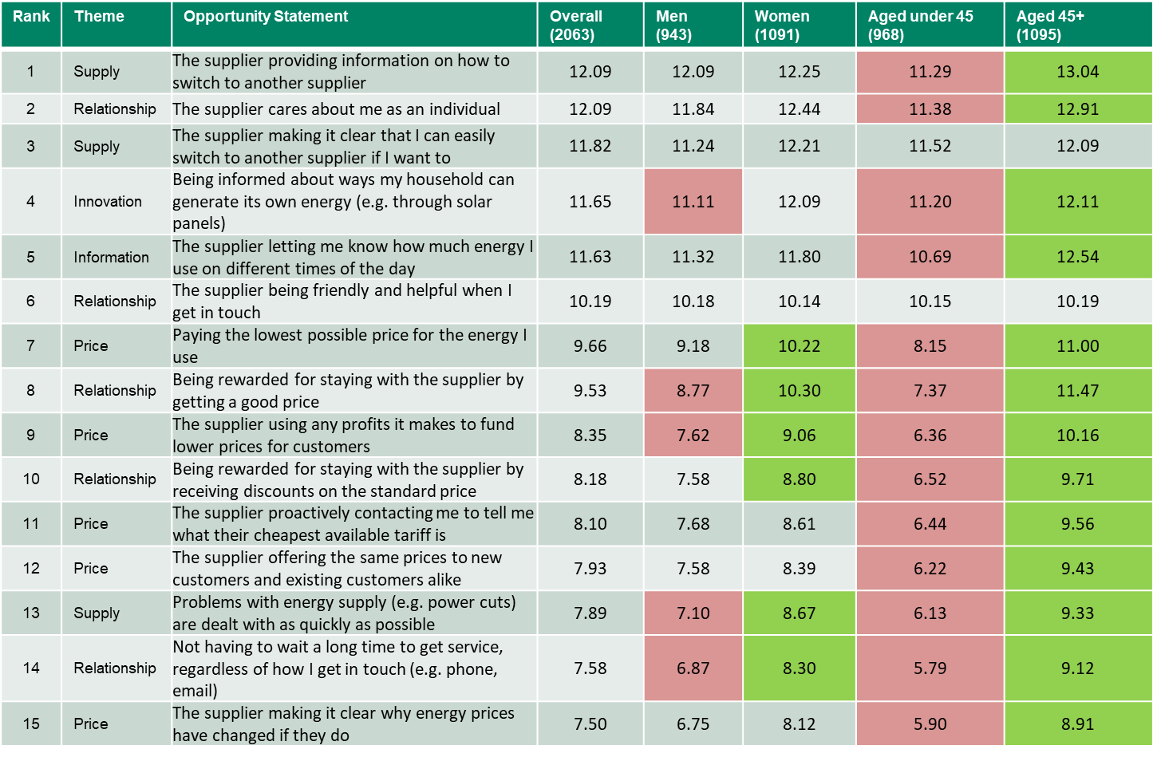
Opportunity Scores
(By gender, age)
Source: ICS Customer Service in the Energy sector – online survey April 2019.
QIMP: How important or unimportant are each of the following to you when it comes to choosing an energy supplier? / QPER: Now thinking about your current energy supplier, how much do you agree or disagree with the below statements?
Base: See table
Significantly higher, Significantly lower

Slide 110
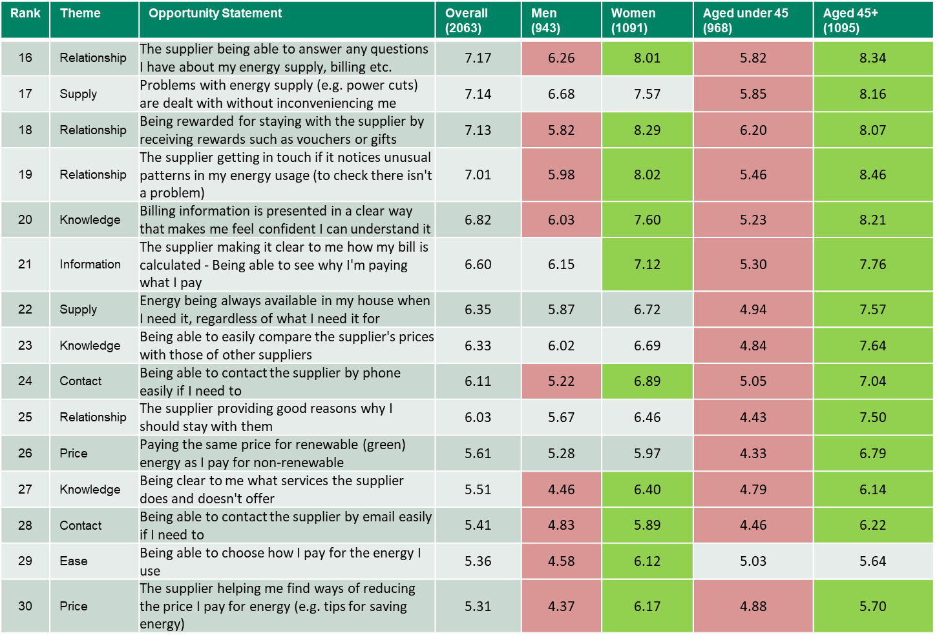
Opportunity Scores
(By gender, age)
Source: ICS Customer Service in the Energy sector – online survey April 2019.
QIMP: How important or unimportant are each of the following to you when it comes to choosing an energy supplier? / QPER: Now thinking about your current energy supplier, how much do you agree or disagree with the below statements?
Base: See table
Significantly higher, Significantly lower

Slide 111
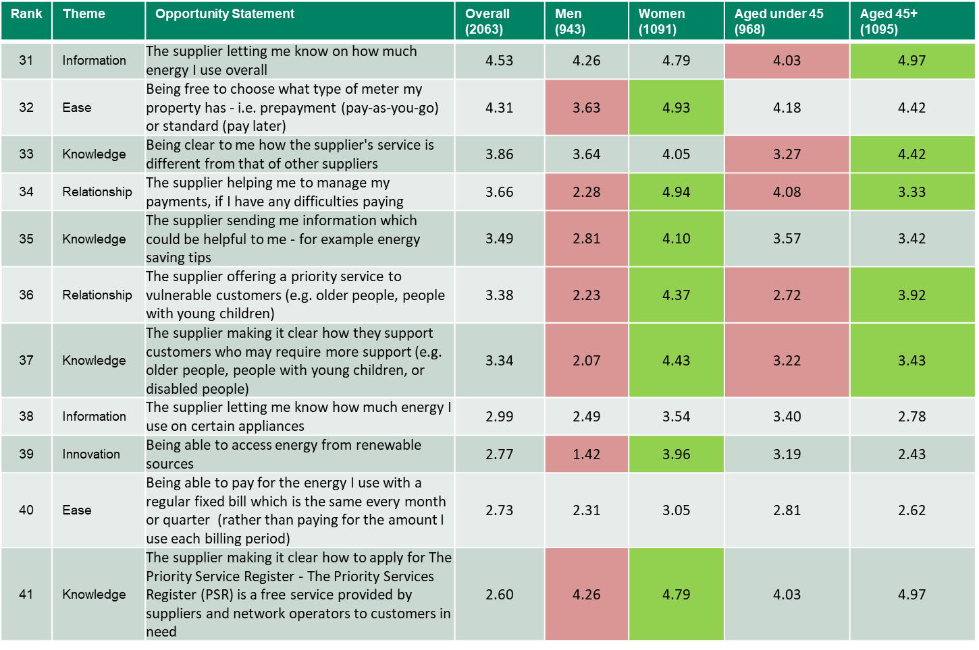
Opportunity Scores
(By gender, age)
Source: ICS Customer Service in the Energy sector – online survey April 2019.
QIMP: How important or unimportant are each of the following to you when it comes to choosing an energy supplier? / QPER: Now thinking about your current energy supplier, how much do you agree or disagree with the below statements?
Base: See table
Significantly higher, Significantly lower

Slide 112
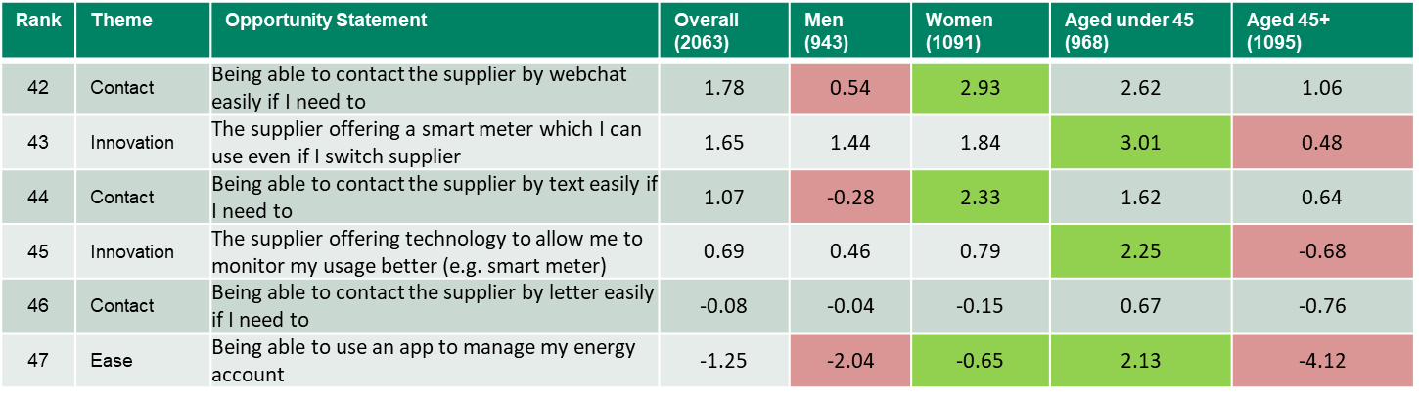
Opportunity Scores
(By gender, age)
Source: ICS Customer Service in the Energy sector – online survey April 2019.
QIMP: How important or unimportant are each of the following to you when it comes to choosing an energy supplier? / QPER: Now thinking about your current energy supplier, how much do you agree or disagree with the below statements?
Base: See table
Significantly higher, Significantly lower

Slide 113
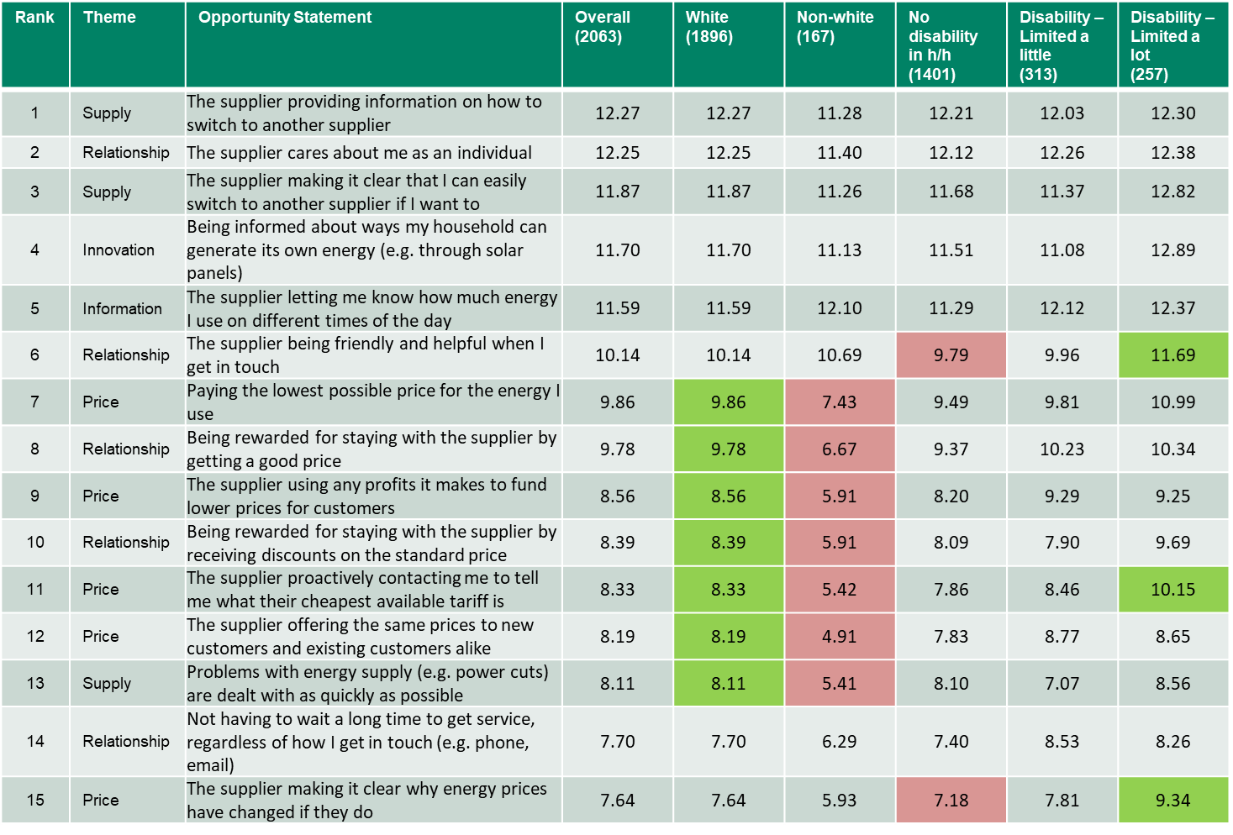
Opportunity Scores
(By ethnicity, disability)
Source: ICS Customer Service in the Energy sector – online survey April 2019.
QIMP: How important or unimportant are each of the following to you when it comes to choosing an energy supplier? / QPER: Now thinking about your current energy supplier, how much do you agree or disagree with the below statements?
Base: See table
Significantly higher, Significantly lower

Slide 114
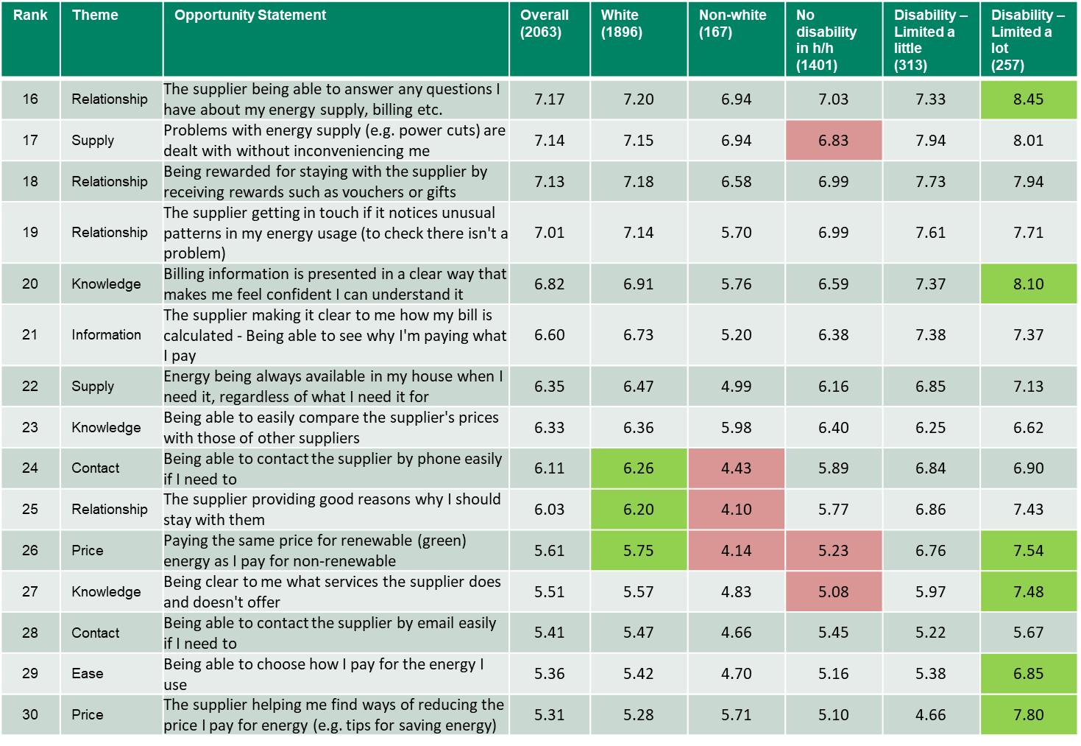
Opportunity Scores
(By ethnicity, disability)
Source: ICS Customer Service in the Energy sector – online survey April 2019.
QIMP: How important or unimportant are each of the following to you when it comes to choosing an energy supplier? / QPER: Now thinking about your current energy supplier, how much do you agree or disagree with the below statements?
Base: See table
Significantly higher, Significantly lower

Slide 115
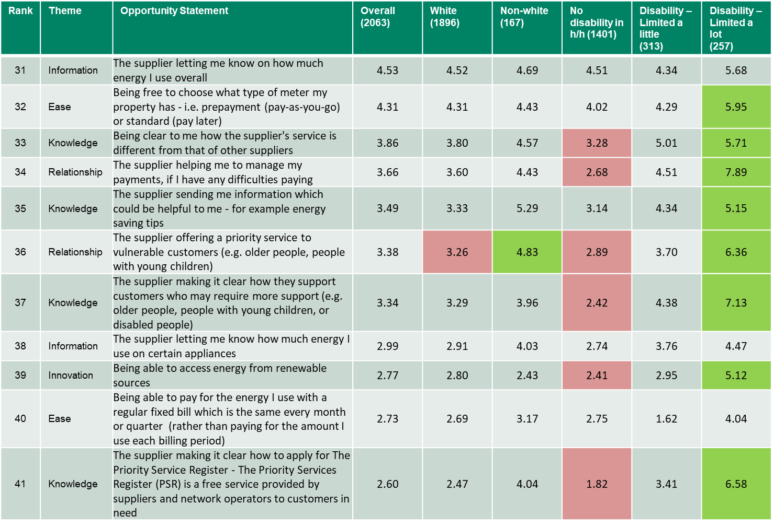
Opportunity Scores
(By ethnicity, disability)
Source: ICS Customer Service in the Energy sector – online survey April 2019.
QIMP: How important or unimportant are each of the following to you when it comes to choosing an energy supplier? / QPER: Now thinking about your current energy supplier, how much do you agree or disagree with the below statements?
Base: See table
Significantly higher, Significantly lower

Slide 116
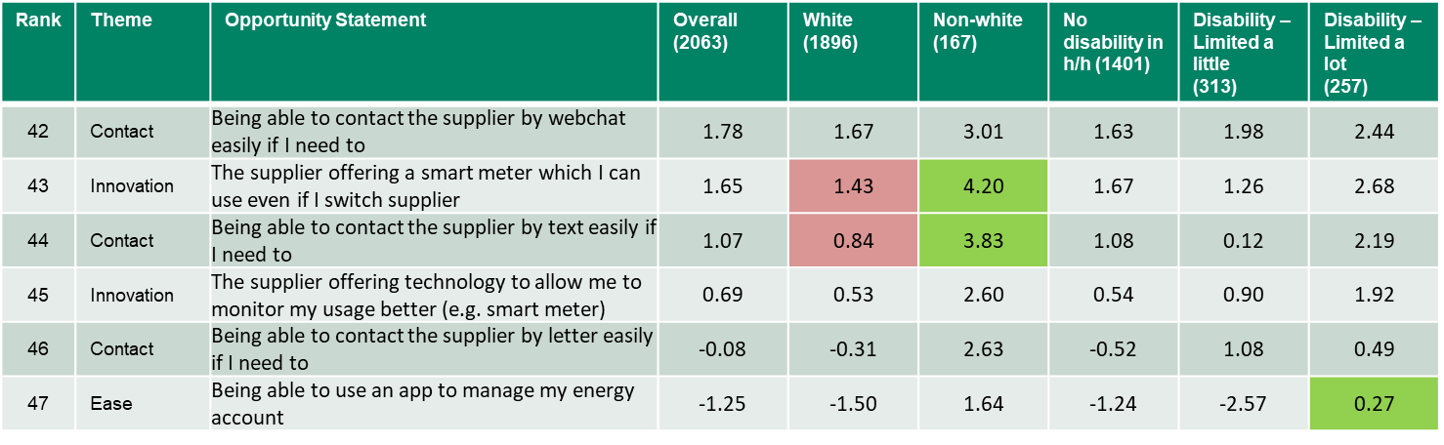
Opportunity Scores
(By ethnicity, disability)
Source: ICS Customer Service in the Energy sector – online survey April 2019.
QIMP: How important or unimportant are each of the following to you when it comes to choosing an energy supplier? / QPER: Now thinking about your current energy supplier, how much do you agree or disagree with the below statements?
Base: See table
Significantly higher, Significantly lower

Slide 117
Extra satisfaction analysis (appendix 2)

Slide 118







Customer service in regulated sectors
Trends in satisfaction dimension by sector over 3.5 years
Satisfaction by age and by sector across all dimensions age
2nd July 2019

Slide 119
Overall data included for context

Slide 120
Mean satisfaction
(scale 1-10)
7.96
Overall Satisfaction
Three out of four are satisfied with their energy supplier…
but there is opportunity for improvement
7.94
UK All sector average 7.61
7.50
7.35
7.32
% Overall satisfaction – by sector
Source: ICS Customer Service in the Energy sector – Desk based research, April 2019.
Q3. How satisfied or dissatisfied are you with XX overall?
Base: UKCSI Data Jan 2016 – Jan 2019 (See chart)
Significantly higher when compared to the UK All sector average (7.61), Significantly lower when compared to the UK All sector average (7.61)

Slide 121
Overall satisfaction over time
Despite stability of 5 key drivers there has been a slight decline since July 2018
Satisfaction with top 5 drivers, and overall for energy supplier – by wave
Mean satisfaction scores (Scale 1-10)
Source: ICS Customer Service in the Energy sector – Desk based research, April 2019.
Q2: We would like to know how satisfied or dissatisfied you are with XX by asking you to score the list of factors below. So thinking about your last experience of XX, what score would you give for: / Q3: How satisfied or dissatisfied are you with XX overall?
Base: See chart

Slide 122
Satisfaction trends by sector
January 2016 - January 2019

Slide 123
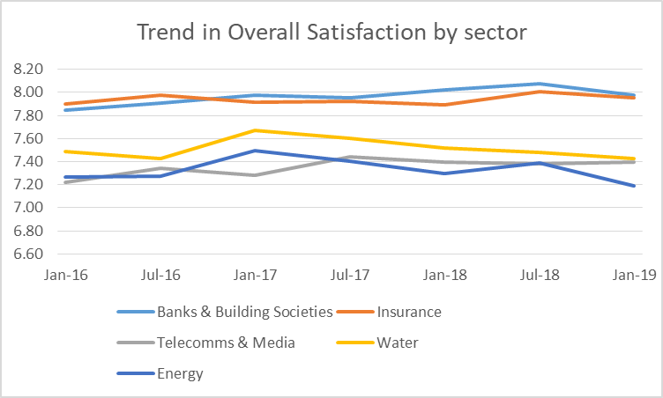
There is very little variation by sector or over time, with the highest score being 8.08 and the lowest being 7.19
Trend in Overall Satisfaction by sector over 3.5 years
(Jan 2016-Jan 2019)
Apart from Jan 2017, Energy scores consistently lower than other regulated sectors for overall satisfaction
 | Trend in Overall Satisfaction by sector
 | Jan-16 | Jul-16 | Jan-17 | Jul-17 | Jan-18 | Jul-18 | Jan-19
Banks & Building Societies | 7.85 ↓ | 7.90 | 7.98 | 7.95 | 8.02 | 8.08 ↑ | 7.98
Insurance | 7.90 | 7.98 | 7.91 | 7.92 | 7.89 | 8.01 | 7.96
Telecomms & Media | 7.22 ↓ | 7.34 | 7.28 | 7.44 | 7.39 | 7.38 | 7.40
Water | 7.49 | 7.42 | 7.67 | 7.60 | 7.52 | 7.48 | 7.43
Energy | 7.26 | 7.27 | 7.50 ↑ | 7.40 ↑ | 7.29 | 7.39 | 7.19 ↓
Source: ICS Customer Service in the Energy sector – Desk based research, April 2019.
Q3. How satisfied or dissatisfied are you with XX overall?
Base: UKCSI Data Jan 2016 – Jan 2019 (Banks & Buildings Societies n=10500, Insurance n=12000, Telecomms & Media n=10500, Water n=5334, Energy n=15106).
Significantly higher when compared to the other waves, Significantly lower when compared to the other waves

Slide 124
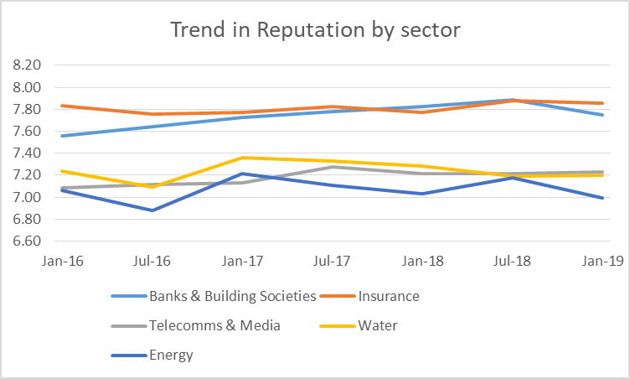
Finance companies out-perform other regulated sectors but the highest score for any sector in this period is only 7.88
Trend in Satisfaction dimensions by sector over 3.5 years
- Reputation
Again, apart from Jan 2017, Energy scores consistently lower than other regulated sectors.
 | Trend in Reputation by sector
 | Jan-16 | Jul-16 | Jan-17 | Jul-17 | Jan-18 | Jul-18 | Jan-19
Banks & Building Societies | 7.56 ↓ | 7.64 ↓ | 7.73 | 7.78 | 7.82 | 7.88 ↑ | 7.75
Insurance | 7.83 | 7.76 | 7.77 | 7.82 | 7.77 | 7.88 | 7.86
Telecomms & Media | 7.08 | 7.11 | 7.13 | 7.28 | 7.21 | 7.22 | 7.23
Water | 7.24 | 7.09 ↓ | 7.36 | 7.33 | 7.28 | 7.19 | 7.20
Energy | 7.06 | 6.88 ↓ | 7.21 ↑ | 7.11 ↑ | 7.03 | 7.18 ↑ | 6.99
Source: ICS Customer Service in the Energy sector – Desk based research, April 2019.
Q2: We would like to know how satisfied or dissatisfied you are with XX by asking you to score the list of factors below. So thinking about your last experience of XX, what score would you give for:
Base: UKCSI Data Jan 2016 – Jan 2019 (Banks & Buildings Societies n=10500, Insurance n=12000, Telecomms & Media n=10500, Water n=5334, Energy n=15106).
Significantly higher when compared to the other waves, Significantly lower when compared to the other waves

Slide 125
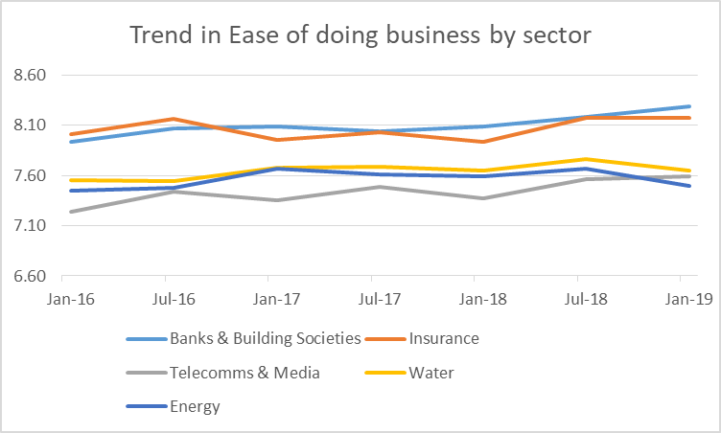
Scores are higher for this dimension than for other components of overall satisfaction – the range is 7.24 to 8.29
Trend in Satisfaction dimensions by sector over 3.5 years
- Ease of doing business
The Energy sector performs better on this dimension – Telecomms and Media is last until Jan 2019 when it overtakes Energy.
 | Trend in Ease of doing business by sector
 | Jan-16 | Jul-16 | Jan-17 | Jul-17 | Jan-18 | Jul-18 | Jan-19
Banks & Building Societies | 7.93 ↓ | 8.07 | 8.09 | 8.04 | 8.09 | 8.19 | 8.29 ↑
Insurance | 8.02 | 8.16 ↑ | 7.96 ↓ | 8.03 | 7.93 ↓ | 8.18 ↑ | 8.17 ↑
Telecomms & Media | 7.24 ↓ | 7.44 | 7.36 | 7.49 | 7.37 | 7.56 ↑ | 7.60 ↑
Water | 7.55 | 7.55 | 7.67 | 7.69 | 7.65 | 7.76 | 7.65
Energy | 7.45 | 7.48 ↓ | 7.67 | 7.61 | 7.59 | 7.67 ↑ | 7.49
Source: ICS Customer Service in the Energy sector – Desk based research, April 2019.
Q2: We would like to know how satisfied or dissatisfied you are with XX by asking you to score the list of factors below. So thinking about your last experience of XX, what score would you give for:
Base: UKCSI Data Jan 2016 – Jan 2019 (Banks & Buildings Societies n=10500, Insurance n=12000, Telecomms & Media n=10500, Water n=5334, Energy n=15106).
Significantly higher when compared to the other waves, Significantly lower when compared to the other waves

Slide 126
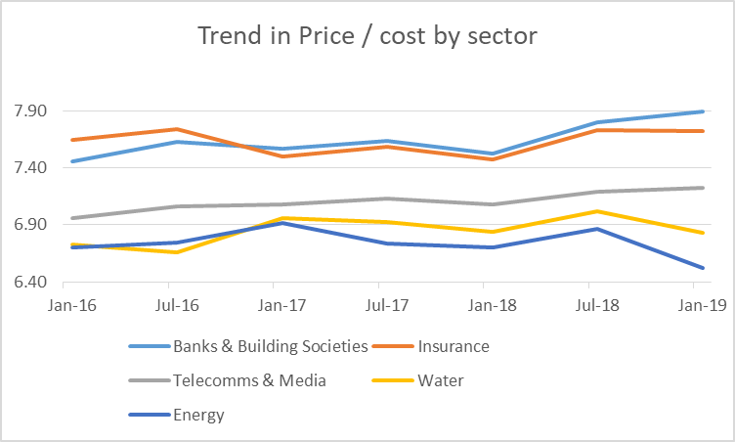
Here, scores are the lowest of all dimensions – the range is 6.52 to 7.90
Trend in Satisfaction dimensions by sector over 3.5 years
- Price / cost
Here, the only time the Energy sector does not perform worst is July 2016.
 | Trend in Price / cost by sector
 | Jan-16 | Jul-16 | Jan-17 | Jul-17 | Jan-18 | Jul-18 | Jan-19
Banks & Building Societies | 7.46 ↓ | 7.63 | 7.57 | 7.64 | 7.52 ↓ | 7.80 ↑ | 7.90 ↑
Insurance | 7.65 | 7.74 ↑ | 7.50 ↓ | 7.58 | 7.47 ↓ | 7.73 ↑ | 7.72 ↑
Telecomms & Media | 6.96 ↓ | 7.07 | 7.08 | 7.14 | 7.08 | 7.19 | 7.23 ↑
Water | 6.73 | 6.66 ↓ | 6.96 | 6.93 | 6.84 | 7.02 ↑ | 6.83
Energy | 6.70 | 6.74 | 6.91 ↑ | 6.73 | 6.70 | 6.86 ↑ | 6.52 ↓
Source: ICS Customer Service in the Energy sector – Desk based research, April 2019.
Q2: We would like to know how satisfied or dissatisfied you are with XX by asking you to score the list of factors below. So thinking about your last experience of XX, what score would you give for:
Base: UKCSI Data Jan 2016 – Jan 2019 (Banks & Buildings Societies n=10500, Insurance n=12000, Telecomms & Media n=10500, Water n=5334, Energy n=15106).
Significantly higher when compared to the other waves, Significantly lower when compared to the other waves

Slide 127
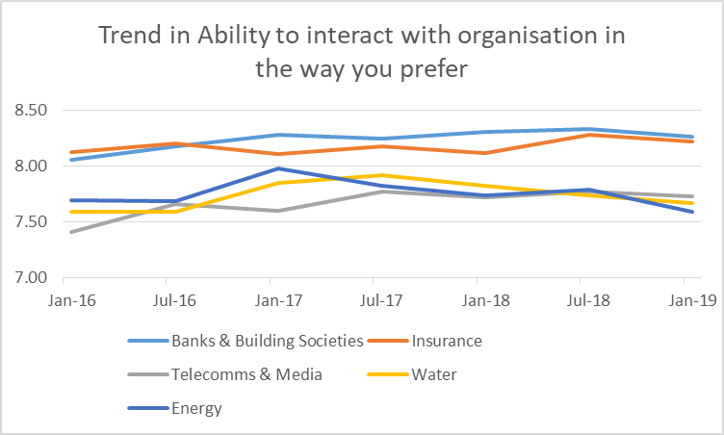
Here, scores are the highest of all dimensions and the range is still small - 7.41 to 8.33
Trend in Satisfaction dimensions by sector over 3.5 years
- Ability to interact with organisation in the way you prefer
Energy performs better in this dimension – possibly due to infrequent customer contact with their energy supplier.
 | Trend in Ability to interact with organisation in the way you prefer
 | Jan-16 | Jul-16 | Jan-17 | Jul-17 | Jan-18 | Jul-18 | Jan-19
Banks & Building Societies | 8.05 ↓ | 8.17 | 8.28 | 8.24 | 8.31 | 8.33 ↑ | 8.26
Insurance | 8.12 | 8.20 | 8.10 | 8.17 | 8.11 | 8.28 ↑ | 8.22
Telecomms & Media | 7.41 ↓ | 7.66 | 7.60 | 7.77 ↑ | 7.72 | 7.76 ↑ | 7.72
Water | 7.59 | 7.59 ↓ | 7.84 | 7.92 ↑ | 7.82 | 7.74 | 7.67
Energy | 7.69 | 7.68 ↓ | 7.97 ↑ | 7.82 ↑ | 7.73 | 7.78 | 7.58 ↓
Source: ICS Customer Service in the Energy sector – Desk based research, April 2019.
Q2: We would like to know how satisfied or dissatisfied you are with XX by asking you to score the list of factors below. So thinking about your last experience of XX, what score would you give for:
Base: UKCSI Data Jan 2016 – Jan 2019 (Banks & Buildings Societies n=10500, Insurance n=12000, Telecomms & Media n=10500, Water n=5334, Energy n=15106).
Significantly higher when compared to the other waves, Significantly lower when compared to the other waves

Slide 128
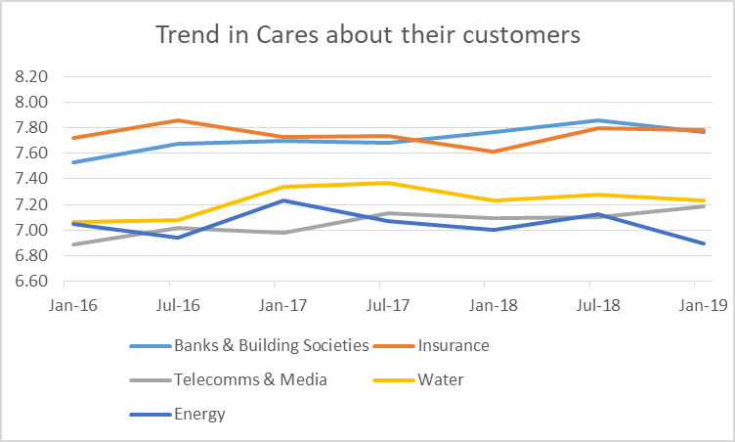
Scores for this dimension are the unremarkable and the range is still small - 6.90 to 7.86
Trend in Satisfaction dimensions by sector over 3.5 years
- Cares about their customers
Energy swaps last place with Telecoms & Media about once a year.
 | Trend in Cares about their customers
 | Jan-16 | Jul-16 | Jan-17 | Jul-17 | Jan-18 | Jul-18 | Jan-19
Banks & Building Societies | 7.53 ↓ | 7.67 | 7.70 | 7.68 | 7.76 | 7.86 ↑ | 7.77
Insurance | 7.72 | 7.85 ↑ | 7.73 | 7.74 | 7.61 ↓ | 7.80 | 7.78
Telecomms & Media | 6.89 ↓ | 7.02 | 6.98 | 7.13 | 7.09 | 7.10 | 7.19 ↑
Water | 7.06 | 7.08 ↓ | 7.34 | 7.37 ↑ | 7.23 | 7.28 | 7.23
Energy | 7.05 | 6.94 ↓ | 7.23 ↑ | 7.07 | 7.00 | 7.12 ↑ | 6.90 ↓
Source: ICS Customer Service in the Energy sector – Desk based research, April 2019.
Q2: We would like to know how satisfied or dissatisfied you are with XX by asking you to score the list of factors below. So thinking about your last experience of XX, what score would you give for:
Base: UKCSI Data Jan 2016 – Jan 2019 (Banks & Buildings Societies n=10500, Insurance n=12000, Telecomms & Media n=10500, Water n=5334, Energy n=15106).
Significantly higher when compared to the other waves, Significantly lower when compared to the other waves

Slide 129
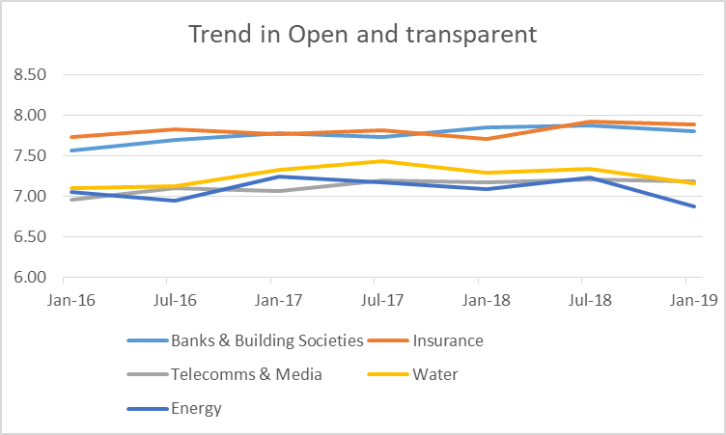
Scores for this dimension are the unremarkable and the range is still small - 6.90 to 7.86
Trend in Satisfaction dimensions by sector over 3.5 years
- Open & transparent
Energy in generally fourth out of the five sectors except in Jan-19 when it hit the low point for this period.
 | Trend in Open & transparent
 | Jan-16 | Jul-16 | Jan-17 | Jul-17 | Jan-18 | Jul-18 | Jan-19
Banks & Building Societies | 7.57 ↓ | 7.69 | 7.78 | 7.73 | 7.85 | 7.88 ↑ | 7.80
Insurance | 7.74 | 7.82 | 7.77 | 7.81 | 7.71 ↓ | 7.92 ↑ | 7.89
Telecomms & Media | 6.96 ↓ | 7.11 | 7.06 | 7.19 | 7.17 | 7.21 | 7.18
Water | 7.10 | 7.13 ↓ | 7.33 | 7.43 ↑ | 7.29 | 7.34 | 7.16
Energy | 7.05 | 6.95 ↓ | 7.24 ↑ | 7.17 ↑ | 7.09 | 7.23 ↑ | 6.87 ↓
Source: ICS Customer Service in the Energy sector – Desk based research, April 2019.
Q2: We would like to know how satisfied or dissatisfied you are with XX by asking you to score the list of factors below. So thinking about your last experience of XX, what score would you give for:
Base: UKCSI Data Jan 2016 – Jan 2019 (Banks & Buildings Societies n=10500, Insurance n=12000, Telecomms & Media n=10500, Water n=5334, Energy n=15106).
Significantly higher when compared to the other waves, Significantly lower when compared to the other waves

Slide 130
Satisfaction variations by age by sector
All dimensions

Slide 131
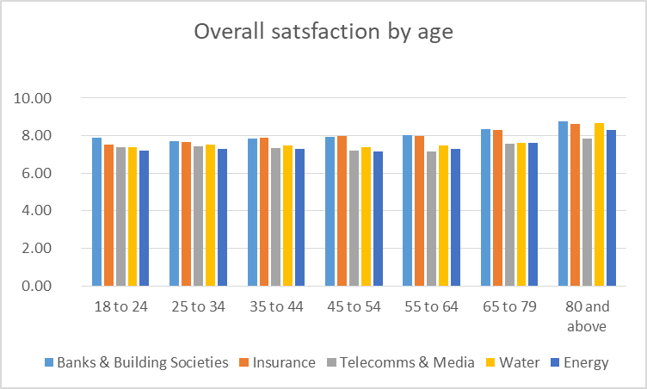
Scores for the oldest segment are markedly higher than other segments and they also show the widest variation
– 7.87 to 8.76
Overall satisfaction by age across sectors
The youngest and oldest segments are most satisfied.
Source: ICS Customer Service in the Energy sector – Desk based research, April 2019.
Q3. How satisfied or dissatisfied are you with XX overall?
Base: UKCSI Data Jan 2016 – Jan 2019 (Banks & Buildings Societies n=10500, Insurance n=12000, Telecomms & Media n=10500, Water n=5334, Energy n=15106).
Significantly higher when compared to the other segments, Significantly lower when compared to the other segments

Slide 132
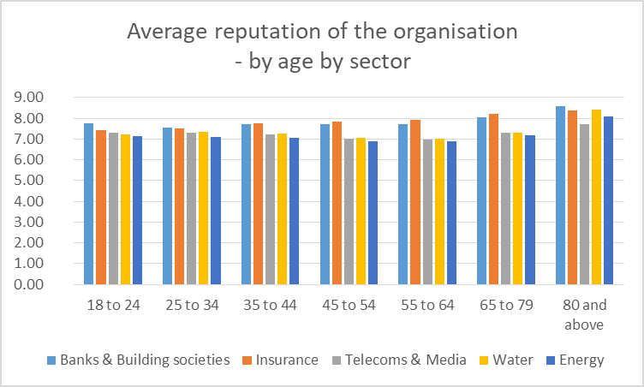
Variation in satisfaction dimensions by sector and age
- Reputation
Source: ICS Customer Service in the Energy sector – Desk based research, April 2019.
Q2: We would like to know how satisfied or dissatisfied you are with XX by asking you to score the list of factors below. So thinking about your last experience of XX, what score would you give for:
Base: UKCSI Data Jan 2016 – Jan 2019 (Banks & Buildings Societies n=10500, Insurance n=12000, Telecomms & Media n=10500, Water n=5334, Energy n=15106).
Significantly higher when compared to the other waves, Significantly lower when compared to the other waves

Slide 133
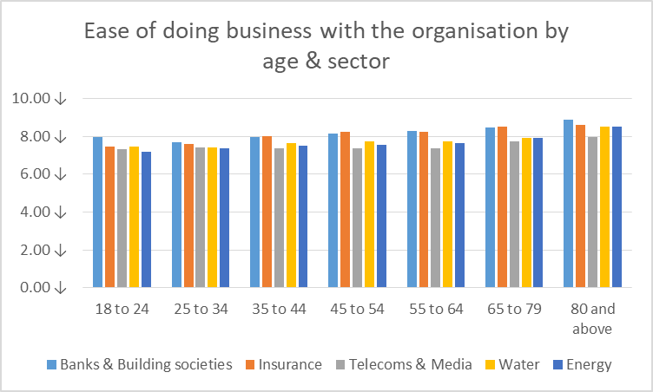
Variation in satisfaction dimensions by sector and age
- Ease of doing business
Source: ICS Customer Service in the Energy sector – Desk based research, April 2019.
Q2: We would like to know how satisfied or dissatisfied you are with XX by asking you to score the list of factors below. So thinking about your last experience of XX, what score would you give for:
Base: UKCSI Data Jan 2016 – Jan 2019 (Banks & Buildings Societies n=10500, Insurance n=12000, Telecomms & Media n=10500, Water n=5334, Energy n=15106).
Significantly higher when compared to the other waves, Significantly lower when compared to the other waves

Slide 134
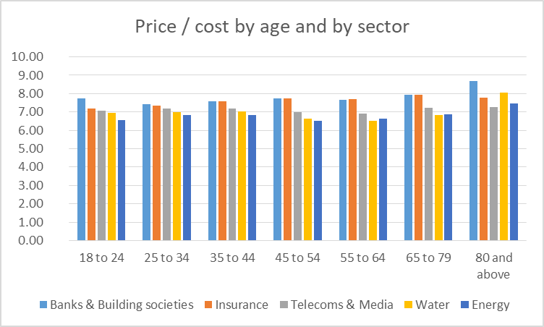
Variation in satisfaction dimensions by sector and age
- Price / cost
Source: ICS Customer Service in the Energy sector – Desk based research, April 2019.
Q2: We would like to know how satisfied or dissatisfied you are with XX by asking you to score the list of factors below. So thinking about your last experience of XX, what score would you give for:
Base: UKCSI Data Jan 2016 – Jan 2019 (Banks & Buildings Societies n=10500, Insurance n=12000, Telecomms & Media n=10500, Water n=5334, Energy n=15106).
Significantly higher when compared to the other waves, Significantly lower when compared to the other waves

Slide 135
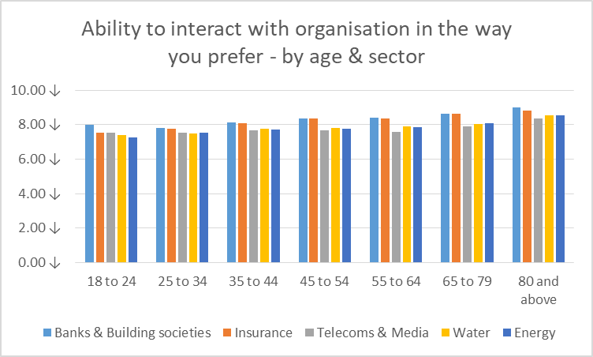
Variation in satisfaction dimensions by sector and age
- Ability to interact with organisation in the way you prefer
Source: ICS Customer Service in the Energy sector – Desk based research, April 2019.
Q2: We would like to know how satisfied or dissatisfied you are with XX by asking you to score the list of factors below. So thinking about your last experience of XX, what score would you give for:
Base: UKCSI Data Jan 2016 – Jan 2019 (Banks & Buildings Societies n=10500, Insurance n=12000, Telecomms & Media n=10500, Water n=5334, Energy n=15106).
Significantly higher when compared to the other waves, Significantly lower when compared to the other waves

Slide 136
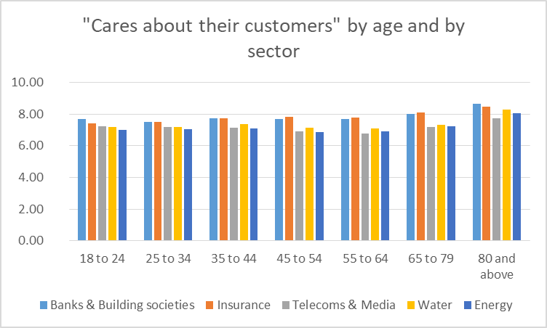
Variation in satisfaction dimensions by sector and age
- Cares about their customers
Source: ICS Customer Service in the Energy sector – Desk based research, April 2019.
Q2: We would like to know how satisfied or dissatisfied you are with XX by asking you to score the list of factors below. So thinking about your last experience of XX, what score would you give for:
Base: UKCSI Data Jan 2016 – Jan 2019 (Banks & Buildings Societies n=10500, Insurance n=12000, Telecomms & Media n=10500, Water n=5334, Energy n=15106).
Significantly higher when compared to the other waves, Significantly lower when compared to the other waves

Slide 137
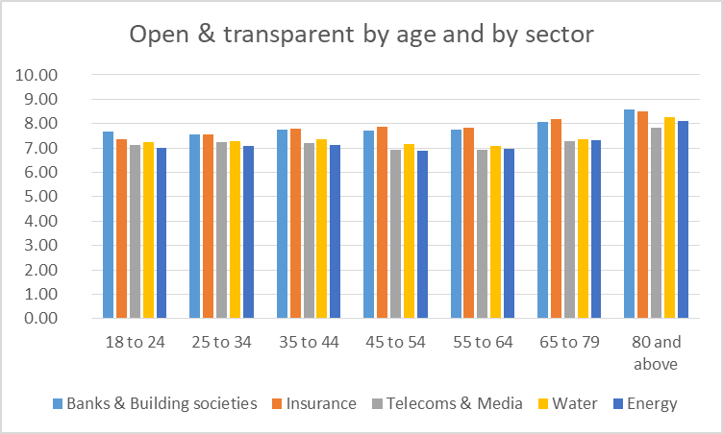
Variation in satisfaction dimensions by sector and age
- Open & transparent
Source: ICS Customer Service in the Energy sector – Desk based research, April 2019.
Q2: We would like to know how satisfied or dissatisfied you are with XX by asking you to score the list of factors below. So thinking about your last experience of XX, what score would you give for:
Base: UKCSI Data Jan 2016 – Jan 2019 (Banks & Buildings Societies n=10500, Insurance n=12000, Telecomms & Media n=10500, Water n=5334, Energy n=15106).
Significantly higher when compared to the other waves, Significantly lower when compared to the other waves

