Slide 1


Household Consumer Perceptions of the energy market – Ethnically minoritised communities Sample
Quarter 1 2021
Research conducted in February 2021

Slide 2
Contents
1
Background and method
2
Sample profile
3
Satisfaction with supplier
4
Complaints
5
Tariffs and information provision
6
Switching
7
Smart Meters
8
Supplier debt management processes
9
Annexes

Slide 3

Background and method

Slide 4
Background
Citizens Advice and Ofgem jointly run a GB survey looking at domestic consumer perceptions of the energy market. The tracker is a representative survey of domestic energy bill-payers and provides Ofgem and Citizens Advice with ongoing measures of consumer engagement in, and experiences of, the energy market.
In February 2021, Citizens Advice decided to run an additional wave of the survey to look at the experiences of consumers from ethnic minority backgrounds to better identify the experiences of this group when interacting with the energy retail market. This additional survey was commissioned by Citizens Advice, and carried out by the research agency Accent.
The questions asked in the survey are the same as in the GB survey, but the respondents are all from an ethnic minority background. This report presents the results of this additional survey.
Citizens Advice helps millions of people every year to find a way forward, across all sectors, whatever their problems. This survey informs its role as the statutory energy consumer advocate, fighting for the best outcomes for current and future consumers.

Slide 5
Methodology
Data was collected using an online survey of 3,500 domestic energy bill-payers in Great Britain (GB). Fieldwork was carried out in January and February, working within the covid-19 restrictions that were in place at that time. Fieldwork included:
  An online survey using a commercial online panel (n = 3,200).
  An online ‘boost’ sample of ethnic minority participants (n-300).
  Face to face interviews are usually utilised to allow for inclusion of the digitally excluded population. However, in light of the coronavirus outbreak, the face to face interviews were not conducted this wave. Face to face interviewing will only continue going forward in Tiers where market research interviewing is permitted and in accordance with the Market Research Society’s guidance on social distancing.
Notes on participant selection:
All participants were responsible (solely or jointly) for the energy bills in their household and for choosing their energy supplier.
The survey used quotas to achieve a sample representative of the GB bill-payer population. Quotas were set on age, gender, social grade and region. For the this sample, quotas were set on Black, Asian and other minority ethnicities only. Data were weighted to the known profile of the GB population. Quotas (other than gender) were based on census Household Reference Person (HRP)*, as a proxy for bill-payer.
* https://www.nomisweb.co.uk/datasets/st067

Slide 6
Comparisons between survey waves
This report presents results for the tenth tracking wave.
As the survey involved sampling a selection of energy consumers, rather than the whole population, confidence intervals apply to the results. These intervals indicate, for a given sample size and survey result, the degree of confidence we can have that the survey result is real and not due to random chance. For the total sample on which these results are based (n=3,200), there is a confidence interval of +/-2% (i.e. a survey result of 50% could lie between 48% and 52%).
Confidence intervals also apply when comparing results between waves. Where there are statistically significant differences in findings to previous waves (i.e. we have statistical confidence that a real change has occurred), these are indicated. Where only wave ten results are shown, there are no statistically significant differences in findings from previous waves.
All measures of statistical significance have been tested at the 95% confidence level.

Slide 7
Abbreviations/terms used in this report
Tariffs / Payment:
Fixed = Consumer is on a fixed tariff for their electricity and gas.
SVT = Consumer is on a Standard Variable Tariff for their electricity and gas.
Mixed tariff = on different types of tariff for gas and electricity.
Dual Fuel = Consumer uses the same supplier for electricity and gas.
PPM = Pre-payment Meter.
Demographics:
SEG = Socio-Economic grade.
ABC1 = Consumers falling into the top three socio-economic bands.
C2DE = Consumers falling into the bottom three socio-economic bands.
Online = Survey sample sourced from an online consumer panel.
Digitally excluded = Sample sourced from face-to-face in-home interviews. All selected on the basis they have no or limited access to the internet.
Other:
PCW = Price Comparison Website.
PPS = Percentage points.

Slide 8

Sample profile

Slide 9
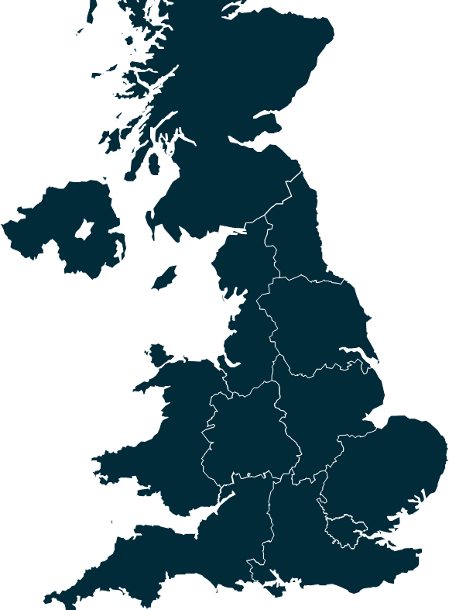
Sample profile
Scotland
2%
NE
1%
Age
Gender
NW
8%
Y&H
6%
EM
6%
WM
11%
Social Grade
Wales
2%
E
9%
London
39%
SW
3%
SE
15%
Base: Ethnic minority (300)

Slide 10

Satisfaction with supplier

Slide 11
Overall satisfaction with supplier and customer service
Satisfaction levels among ethnic minority groups are similar to the levels seen among general consumers. When it comes to customer service, it can be seen that ethnic minority groups shared a similar experience to the general consumer group. This suggests that, generally, overall satisfaction depends on individual energy suppliers and not the consumer’s background.
Satisfaction with supplier
Satisfaction with supplier customer service
Overall, how satisfied or dissatisfied are you with (...) as your supplier of (gas/electricity/gas and electricity)?
Base: Ethnic minority (300), All Participants (3,200)
Overall, how dissatisfied or satisfied are you with the customer service you have received from your energy supplier?
Base: Ethnic minority (300), All Participants (3,200)
11

Slide 12
Satisfaction with bill
Around 3 in 4 consumers are satisfied with the accuracy and ease of understanding bills. No statistical differences can be seen when comparing the ethnic minority group to the overall population group.
Satisfaction with bill – Ethnic Minority
Satisfaction with bill – Overall
Please can you tell me how dissatisfied or satisfied you are with the following aspects of your energy supplier’s bills?
Base: Those who pay for their energy with a regular direct debit or standing order or with cash/cheque/credit card/BACS/App – Ethnic minority (262) – Overall Participants (2,734)
12

Slide 13
Reasons for dissatisfaction with ease of understanding the bill
For both the overall population group and the ethnic minority group, the most common problem was dissatisfaction with how easy their bills were to understand.
Satisfaction with the ease of understanding your bill
*
Why are you very dissatisfied/dissatisfied with the ease of understanding your bill from your energy supplier?
Base: Those who are dissatisfied with the ease of understanding their bill from their energy supplier – Ethnic minority (26) Overall (242)
*Caution small base size

Slide 14
Recent contact with supplier (last 3 months)
Around a third of customers contacted their energy supplier in the last 3 months. While this figure is marginally higher among ethnic minority groups, no significant differences can be seen when compared to the overall group.
Contact energy supplier– Ethnic Minority
Contact energy supplier– Overall
Have you contacted, or tried to contact, your energy supplier within the last 3 months?
Base: Ethnic minority (300), All Participants (3,200)

Slide 15
Recent contact with supplier: channel & reason
Telephone is the most common contact method, followed by email. Giving meter readings and billing enquiries remain the top reasons for contact. The most common reasons for failure to contact are a lack of response from the energy supplier, or the inability of the customer to locate the contact details. This is consistent regardless of background and demography.
Method used to contact suppliers
Reasons for last contacting supplier
Method of contact
Reasons for contact
How did you (try to) make contact with your energy supplier on that last occasion? (%)
Base: All who contacted or have tried to make contact in the last 3 months : Ethnic minority (116), All Participants (1,102)
Thinking of the last time you (made/tried to make) contact with your energy supplier, what was it about? (%)
Base: Those who contacted / tried to contact their energy supplier - Ethnic minority (116), All Participants (1,102)

Slide 16
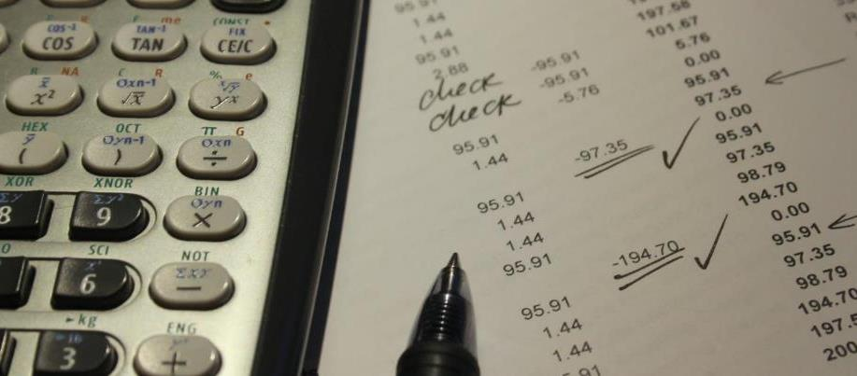
Tariffs and information provision

Slide 17
Tariff type
Consumers from an ethnic minority background were less likely to be unsure about which type of gas/ electricity tariff they had (4% compared to 11% over the overall population group. Consumers from an ethnic minority background are also significantly more likely to be on a standard variable tariff for electricity.
Gas
Electricity
What kind of gas / electricity tariff are you on?
Base: Overall - Gas (2,740), Electricity (3,048)
Ethnic minority – Gas (251), Electricity (264)
17
Significantly lower than overall
Significantly higher than overall

Slide 18
How well information meets needs
In general, information provided by suppliers is seen to meet the needs of all customers, including those from an ethnic minority background. However improvements can be made around providing assistance with paying and escalating complaints for consumers from an ethnic minority background.
The supplier has given you information about any of the following
How well you find the info
85% | 11%
89% | 7%
89% | 9%
86% | 10%
88% | 9%
82% | 9%
87% | 12%
90% | 6%
82% | 14%
Fairly/very well | Not at all/not very well
Do you recall if your energy supplier has given you information about any of the following in the last six months? Base: Ethnic minority (300), All Participants (3,200) , apart from ‘Notification of price increase – Not show prefer not to answer
How well did the information you received meet your needs? Bases: those receiving information among Ethnic Minority
18
Significantly lower than overall
Significantly higher than overall

Slide 19

Switching

Slide 20
How many consumers have ever switched supplier?
Ethnic minority groups are significantly less likely than the overall population to have switched energy supplier or consider switching.
Ever switch or consider switching
Last time you switched supplier
Currently consider switching
Have you ever switched or considered switching energy supplier?
Base: Ethnic minority (300), All Participants (3,200)
When was the last time you switched energy supplier?
Base: Those who have ever switched – Ethnic minority (102), Overall (1,405)
Are you currently considering changing your energy supplier?
Base: : Ethnic minority (300), All Participants (3,200)
20
Significantly lower than overall
Significantly higher than overall

Slide 21
Reasons for choosing supplier
While tariff and price remained the top reasons for switching energy supplier, ethnic minority groups placed considerably more importance on customer service and incentive when compared to the overall group.
Once you had made the decision to switch to another energy supplier, what were the main reasons you chose the company you went with?
Base: Those who have ever switched – Ethnic minority (102), Overall (1,405)
21
Significantly lower than overall
Significantly higher than overall

Slide 22
Use of price comparison websites (PCWs)
Overall, 67% who switched used a Price Comparison Website. This figure is significantly higher among the ethnic minority group compared to the overall group. In addition, although in smaller proportion, ethnic minority groups show a higher tendency to switch using an automated switching service than other methods.
Use a PCW to switch
Find out about the deal
Did you use a price comparison website to help you switch energy supplier?
Base: Those who have ever switched supplier Ethnic minority (102), Overall (1,405)
How did you find out about the energy deal you switched to? Showing top 5 only
Base: :Those who switched their energy supplier Ethnic minority (102), Overall (1,405)
22
Significantly lower than overall
Significantly higher than overall

Slide 23
Source of energy deal information
A significantly higher proportion of the ethnic minority group has heard of Ofgem accreditation for PCW. However no differences in influence levels can be seen among the two groups
Heard of the Ofgem Confidence Code or Ofgem accreditation PCW
Ofgem accreditation influence choice of PCW
Before today, had you ever heard of the Ofgem Confidence Code or Ofgem accreditation for price comparison websites?
Base: Ethnic minority (300), Overall (3200)
To what extent does Ofgem accreditation influence which price comparison website you would use?
Base: All aware Ofgem accreditation for price comparison websites - Ethnic minority (93), Overall (813)
23
Significantly lower than overall
Significantly higher than overall

Slide 24
Satisfaction with the switching experience
There is high satisfaction with the switching process, and ease of comparing suppliers and their prices. These satisfaction levels are similar among the ethnic minority group and the overall sample.
Satisfaction with the switching experience – Ethnic Minority
Satisfaction with the switching experience – Overall
N.B. Neutral and ‘Don’t know’ responses are not shown
Please can you tell me how dissatisfied or satisfied you were with the following aspects of your switch to another supplier?
Base: Those who switched their energy supplier - Ethnic minority (102), Overall (1,405)
24

Slide 25
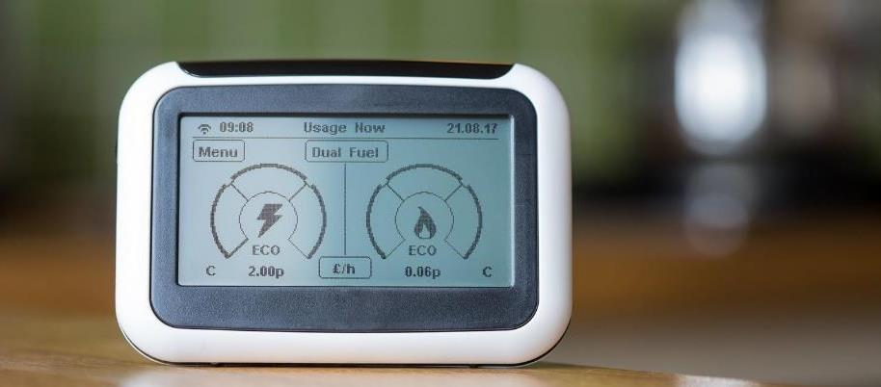
Smart meters

Slide 26
Smart meter use
There is a higher proportion of ethnic minority customers who had their smart meter installed between 3-6 months ago. They also reported higher satisfaction levels when compared to the overall population
When was your smart meter installed?
Satisfaction – Installation process
Satisfaction – Smart meter
When did you have your smart meter installed?
Base: All with smart meter Ethnic minority (102), Overall (1,640)
How dissatisfied or satisfied were you with the process you went through to have a smart meter installed? Base: All with smart meter installed in last 6 months (258)
Overall, how satisfied or dissatisfied are you with your smart meter?
Base: All with a smart meter (1,604)
26
Significantly lower than overall
Significantly higher than overall

Slide 27
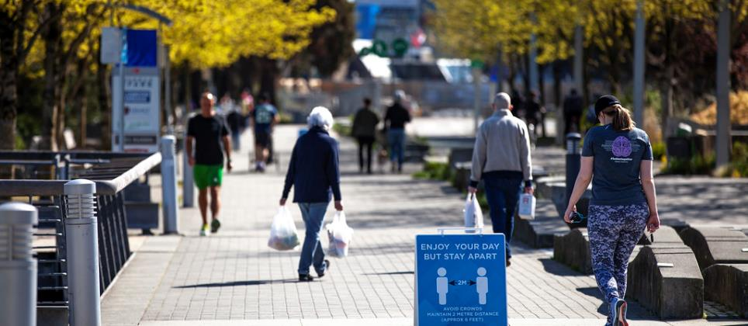
Supplier debt management processes

Slide 28
Problems paying bills
No significant differences can be seen among the ethnic minority group and the overall group when it comes to problems paying bills.
Disconnection from PPM
Contact supplier to ask for help with paying bills
Falling into arrears
Thinking about the past 6 months, has your household run out of credit on your pre-payment meter so that you have been temporarily disconnected from your energy supply? Has your household fallen behind on an energy bill so that you owed money to your energy supplier? Base: Ethnic minority (41), overall (553)
Have you been in contact with your energy supplier to ask for help with paying your bills? Base: All households running out of credit on PPM or running behind on energy payments Base: Ethnic minority (57), overall (509)
28

Slide 29
Supplier support for customers who have fallen behind on bills
Support from energy providers was seen to be consistent among the ethnic minority group and the overall population. The majority of them also thought the support was helpful, sympathetic and fair.
Support offered by suppliers to assist with paying bill
Rating the support offered by suppliers
When you had contact with your energy supplier about your bills, did they do any of the following? Base: All households contacting energy suppliers about running out of credit on PPM or running behind on energy payments – Ethnic minority (41), Overall (309)
To what extent do you agree or disagree with the following statements about the contact you’ve had with your energy supplier about paying your bills: Base: All households contacting energy suppliers about running out of credit on PPM or running behind on energy payments Ethnic minority (41)
29

Slide 30
Annexes

Slide 31
Measuring smart meter use
Use of smart meters is measured by asking participants to indicate which of the following best describes the energy meters they have in their home.
The question is asked separately of gas and electricity. The order of the meter descriptions was randomised across the survey sample.
Those selecting the description for Meter A (the titles remained static) for either gas or electricity are deemed to have a smart meter.
Meter A | Meter B
Monitors energy use | Monitors energy use
Automatically sends readings of how much energy has been used in your home to your supplier | You or someone else in your household personally send readings of how much energy has been used in your home to your supplier OR someone from your supplier visits your home to take meter readings
Shows how much energy has been used in pounds and pence on a display or an app or online account | Does not show how much energy has been used in pounds and pence on a display or an app or online account
Has been installed in the last 5 years | Has been installed more than 5 years ago
SHOW IF HAVE A PRE-PAYMENT METER Allow those who pre-pay for energy to top up via their mobile or online | SHOW IF HAVE A PRE-PAYMENT METER Those who pre-pay for energy must top up at a pay point, post office or other shop
31

Slide 32
Ethnicity Background Q3 2020 – Q2 2021
Ethnicity background groupings for this section of the report are used to further statistically differentiate results. Below are the definitions and sizes of these groups over the last four quarters. Please use caution when making conclusions with lower base sizes.
Grouping: White
English / Welsh / Scottish / Northern Irish / British, Irish, Gypsy or Irish Traveler, Any other White background | 90%, (n=11,581)
Grouping: Mixed Race
White and Black Caribbean, White and Black African, White and Asian, Any other Mixed / Multiple ethnic background | 2%, (n=202)
Grouping: Asian
Indian, Pakistani, Bangladeshi, Chinese, Any other Asian background | 5%, (n=581)
Grouping: Black
African, Caribbean, Any other Black / African / Caribbean background | 3%, (n=336)
Grouping: Other Ethnicity
Arab, Any other ethnic group | 1%, (n=114)
Overall, how satisfied or dissatisfied are you with (...) as your supplier of (gas/electricity/gas and electricity)?
Base: Q3 2020, Q4 2020, Q1 2021, Q2 2021 All participants (12,814)
32

Slide 33
Overall satisfaction with supplier Q3 2020 – Q2 2021
White consumers are the most satisfied over the last four quarters. Black and Mixed Race ethnicity backgrounds are slightly more likely to be dissatisfied with their supplier
Satisfaction with supplier
Net: Satisfied
75%
72%
70%
69%
67%
(11,581)
(581)
(336)
(202)
(114)
Overall, how satisfied or dissatisfied are you with (...) as your supplier of (gas/electricity/gas and electricity)?
Base: Q3 2020, Q4 2020, Q1 2021, Q2 2021 (Bases for ethnic background groups in brackets in chart above)
33

Slide 34
Overall satisfaction with customer service Q3 2020 – Q2 2021
Black and White consumers are the most satisfied with customer service over the last four quarters. Mixed Race ethnicity backgrounds are slightly more likely to be dissatisfied with their supplier’s customer service
Satisfaction with supplier customer service
Net: Satisfied
72%
72%
70%
66%
65%
(336)
(11,581)
(581)
(202)
(114)
Q23. And overall, how dissatisfied or satisfied are you with the customer service you have received from (...)?
Base: Q3 2020, Q4 2020, Q1 2021, Q2 2021 (Bases for ethnic background groups in brackets in chart above)
34

Slide 35
Overall satisfaction with bill Q3 2020 – Q2 202:
Ease of understanding bill
White and Asian consumers are the most satisfied with the ease of understanding their bill over the last four quarters. Mixed Race ethnicity backgrounds are slightly more likely to be dissatisfied or neutral about the ease of understanding their bill
Satisfaction with ease of understanding bill
Net: Satisfied
75%
73%
73%
72%
64%
(11,581)
(581)
(336)
(202)
(114)
Q37r1. Please can you tell me how dissatisfied or satisfied you are with the following aspects of (...)`s bills: Ease of understanding the bill
Base: Q3 2020, Q4 2020, Q1 2021, Q2 2021 (Bases for ethnic background groups in brackets in chart above)
35

Slide 36
Overall satisfaction with bill Q3 2020 – Q2 202:
Accuracy of bill
White consumers are the most satisfied with the accuracy of their bill over the last four quarters. All other ethnicity backgrounds are more likely to be dissatisfied or neutral about the accuracy of their bill
Satisfaction with accuracy of bill
Net: Satisfied
76%
68%
67%
70%
65%
(11,581)
(202)
(581)
(336)
(114)
Q37r2. Please can you tell me how dissatisfied or satisfied you are with the following aspects of (...)`s bills: The accuracy of your bill
Base: Q3 2020, Q4 2020, Q1 2021, Q2 2021 (Bases for ethnic background groups in brackets in chart above)
36

Slide 37
Disconnected or in arrears with supplier Q3 2020 – Q2 2021
Black and mixed race consumers are the groups most likely to have been temporarily disconnected from their energy supply due to running out of credit on their PPM. The same groups are also the most likely to have fallen into arrears. White consumers are significantly less likely to owe money to their suppliers
(96)
(49)*
(87)
(2,017)
(20)*
(251)
(167)
(515)
(9,741)
(95)
*Caution: low base size
*Caution: low base size
Q63aa. Thinking about the past 6 months, has your household run out of credit on your pre-payment meter so that you have been temporarily disconnected from your energy supply?Base: Q3 2020, Q4 2020, Q1 2021, Q2 2021 All PPM (2,269) (Ethnicity base sizes above)
Q63ab. Thinking about the past 6 months, has your household fallen behind on an energy bill so that you owed money to your energy supplier?Base: Q3 2020, Q4 2020, Q1 2021, Q2 2021 All participants with a payment type (10,769) (Ethnicity base sizes above)
37

Slide 38
Concern with ability to pay bills Q3 2020 – Q2 202:
White consumers are least likely to agree they are concerned about their ability to pay their energy bills
I’m concerned I will struggle to pay my energy bills
Net: Agree
38%
37%
33%
30%
22%
Q63ar2. Thinking about the your situation, do you agree or disagree with the following statements: I`m concerned I will struggle to pay my energy bills
Base: Q3 2020, Q4 2020, Q1 2021, Q2 2021 (Bases for ethnic background groups in brackets in chart above)
38

Slide 39
Concern with ability to get in contact with supplier
Q3 2020 – Q2 202:
White consumers are least likely to agree they are concerned that they won’t be able to contact their supplier if they need to
I'm concerned I might not be able to get through to my energy supplier if I need to contact them
Net: Agree
32%
32%
31%
23%
22%
Q63ar4. Thinking about the your situation, do you agree or disagree with the following statements: I’m concerned I might not be able to get through to my energy supplier if I need to contact themBase: Q3 2020, Q4 2020, Q1 2021, Q2 2021 (Bases for ethnic background groups in brackets in chart above)
39

Slide 40

Ben Butler
Tel +44 (0)20 8742 2211
Ben.Butler@accent-mr.com

